Slide 1
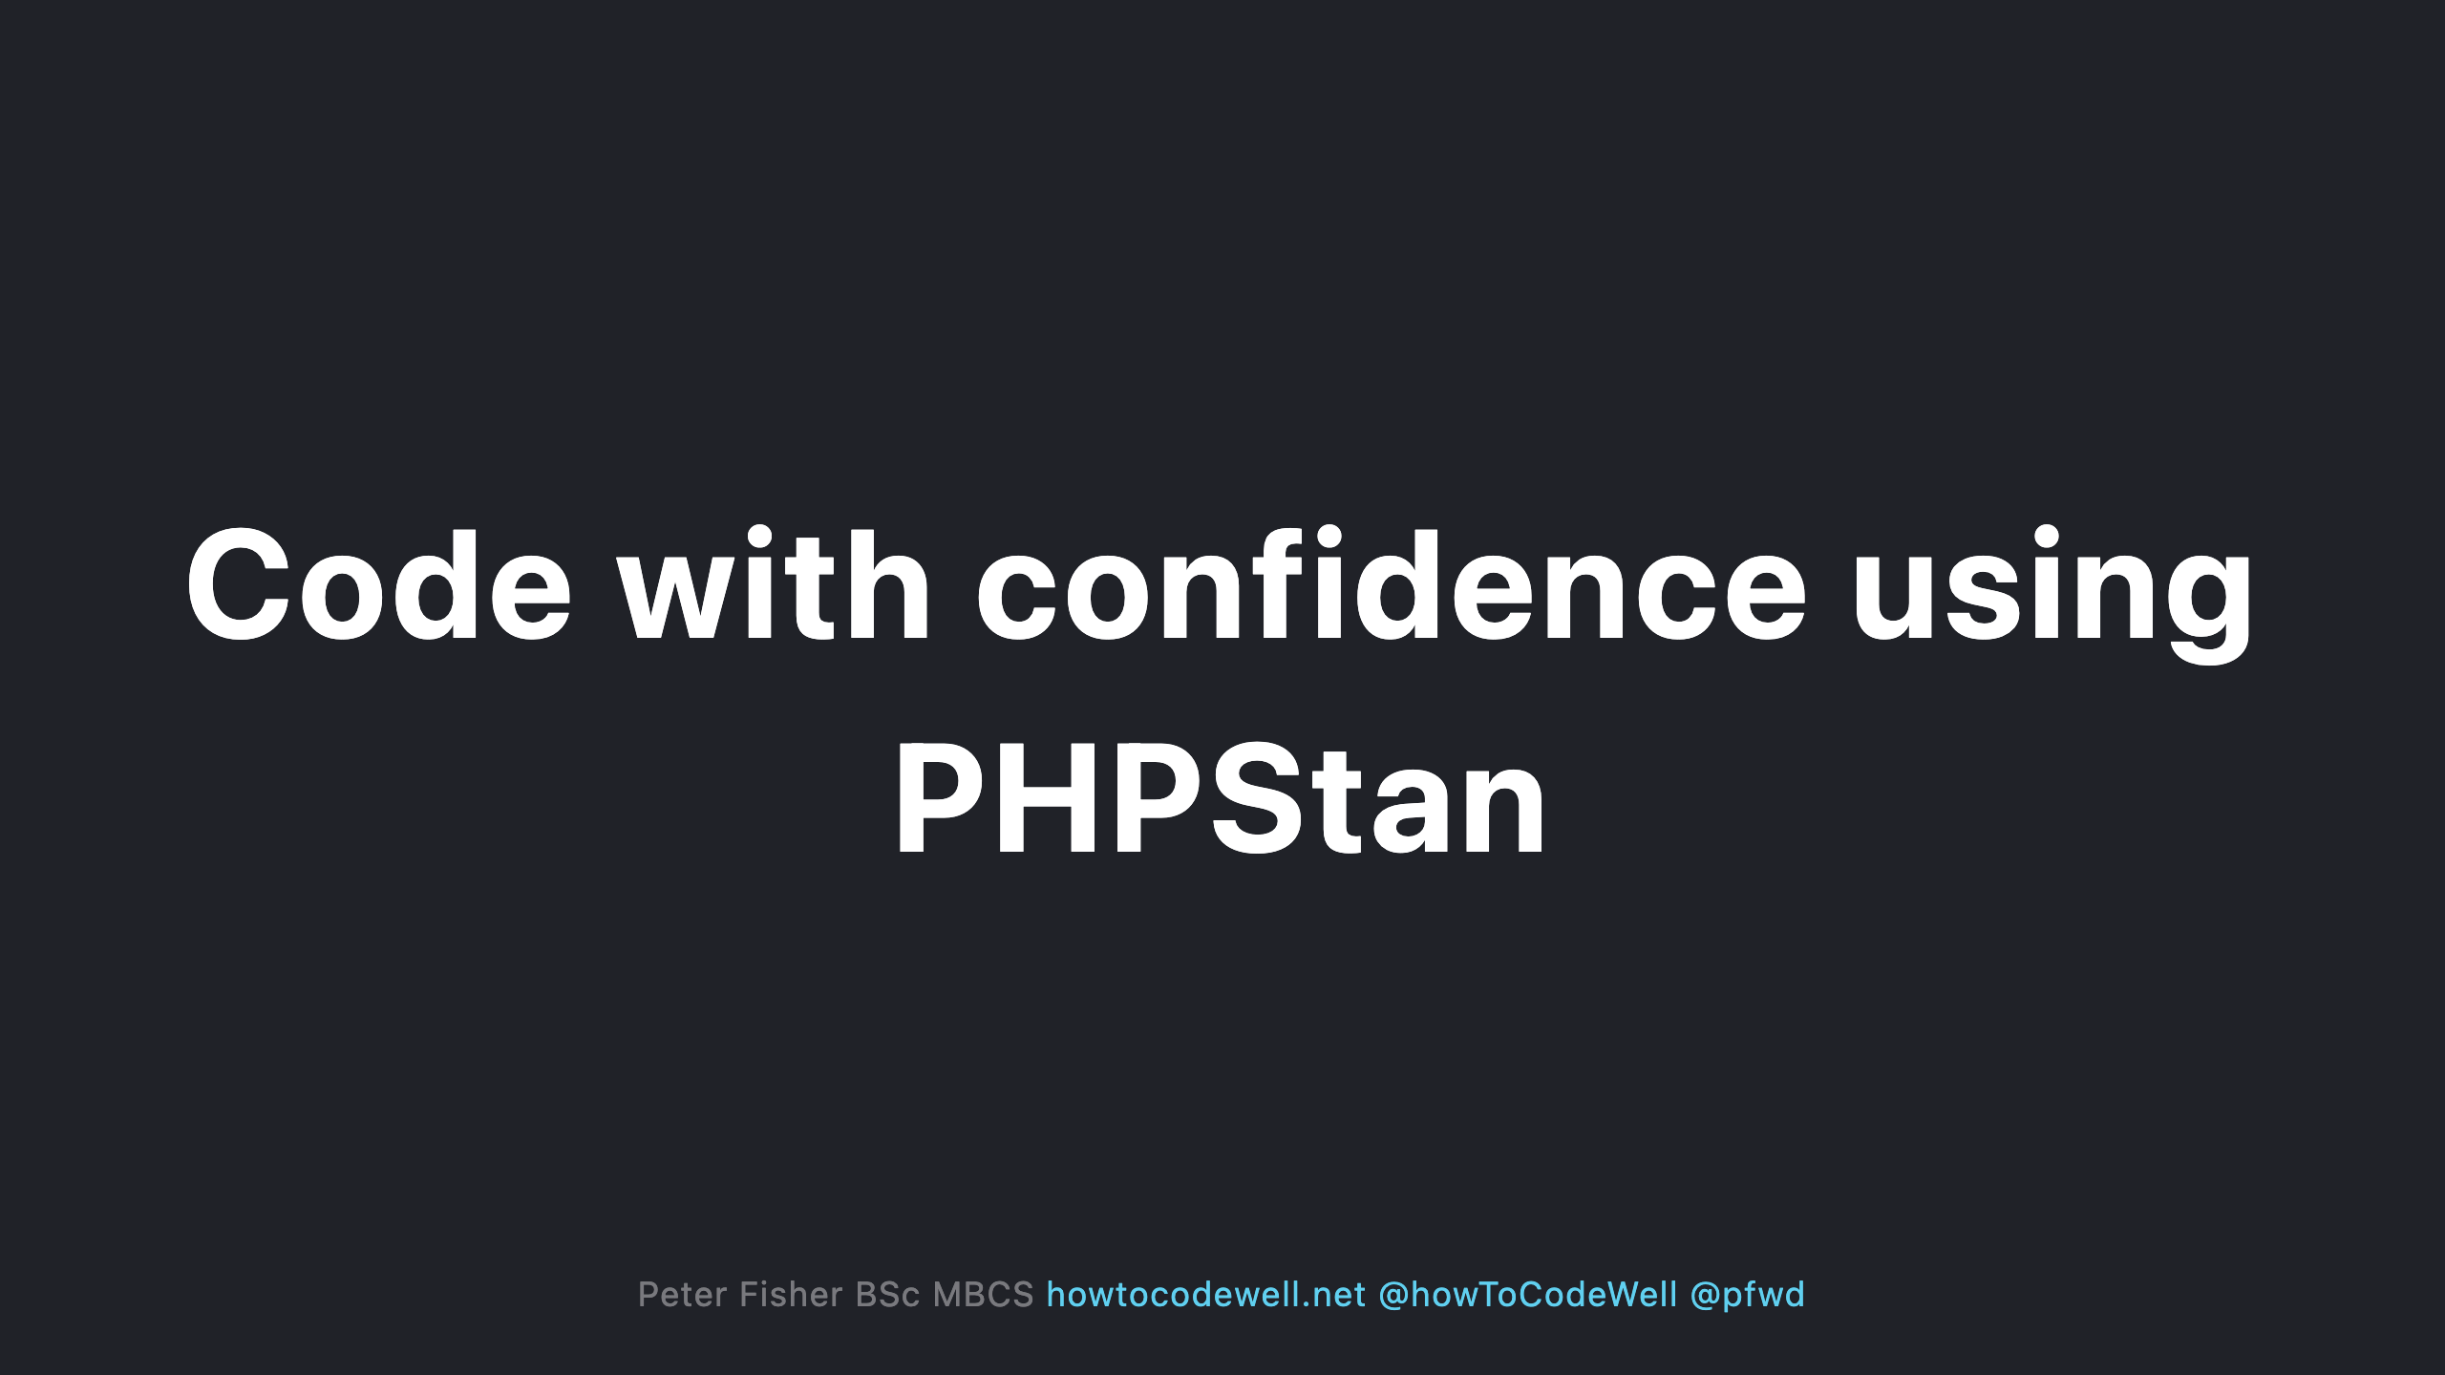

Slide 2
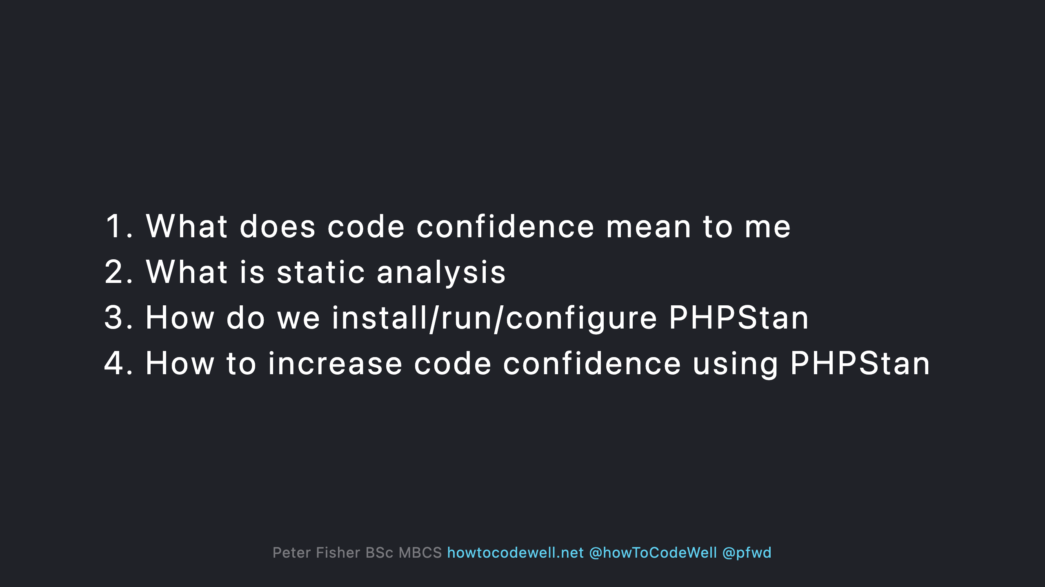

Slide 3
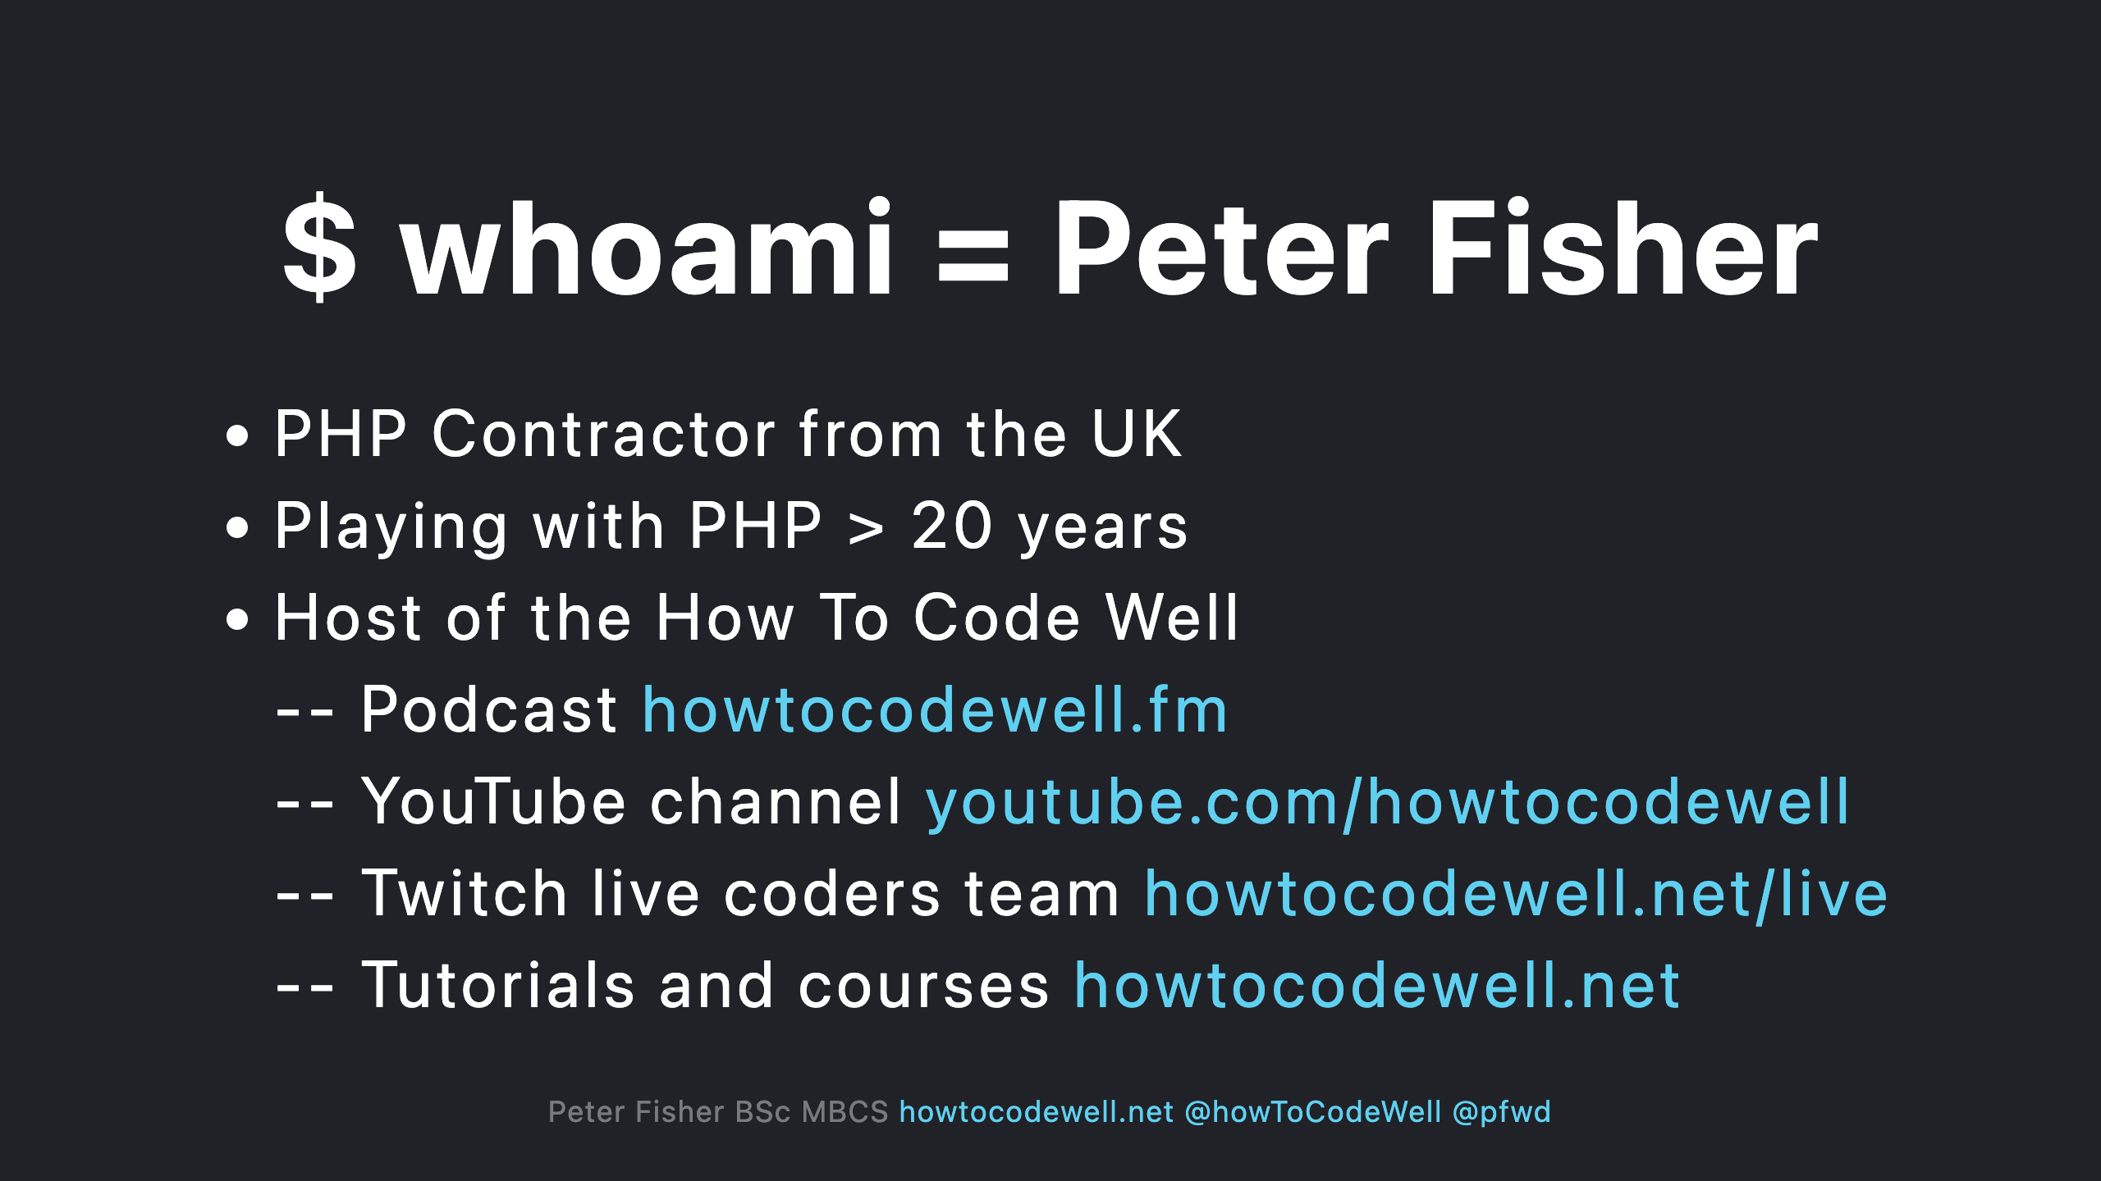

Slide 4
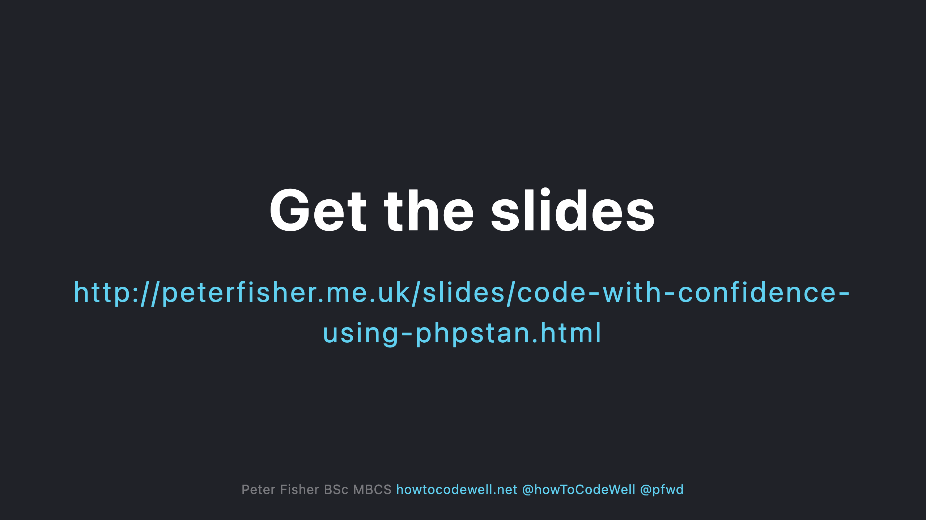

Slide 5
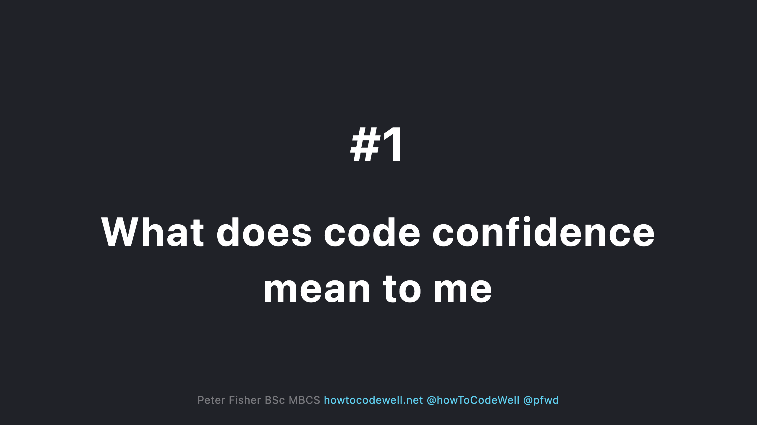

Slide 6
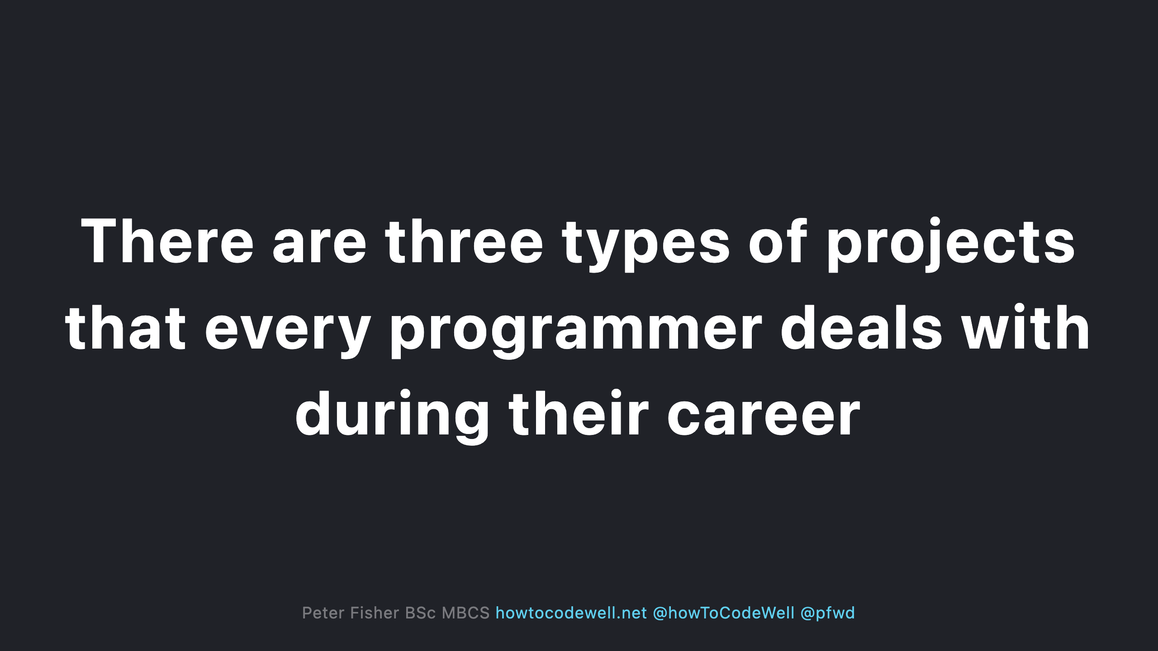

Slide 7
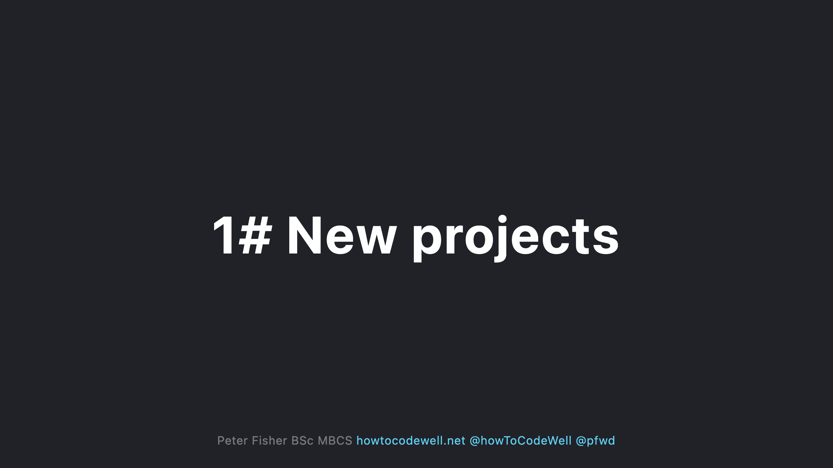
Notes:
- Start from scratch, no code (yet) - No architectural decisions have been made (yet) - No frameworks or library’s chosen (yet) - No bugs (yet) - No end users (yet) - Shopping list of new requirements

Slide 8
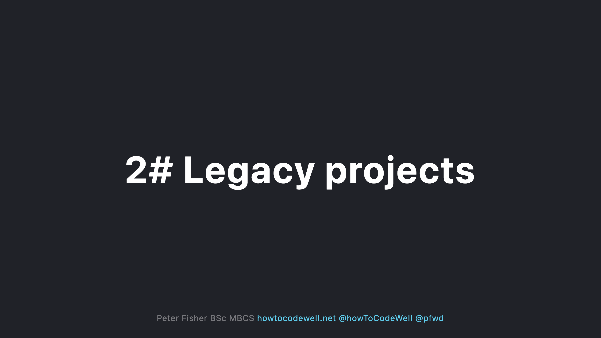
Notes:
- It could be a spaghetti code base - It could have mixture of frameworks and library's - The code could be out of date - It could be using an older version of PHP - It could have incoming change requests - It could have poor technical documentation - There might be 0 tests - There could be lots of known bugs - There could be lots of unknown bugs - There could be many end users. Some might be complaining - There could be performance, security, and data integrity issues - You could have a low confidence that an upgrading or improving something will work

Slide 9
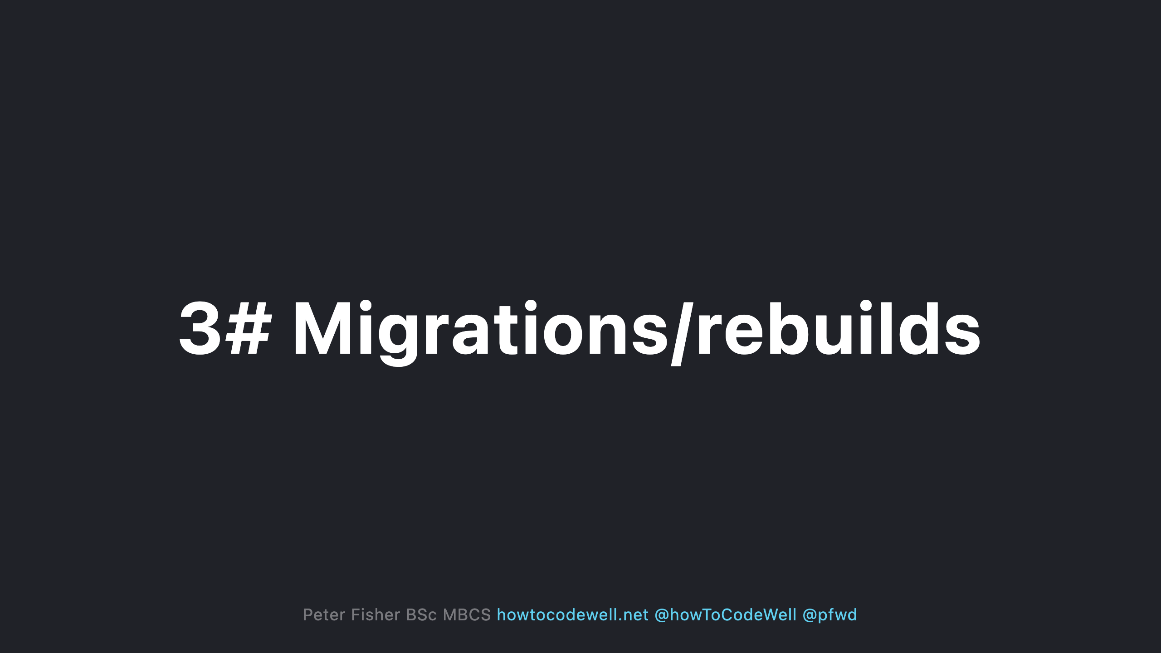
Notes:
- Data integrity could be poor - Existing user base - Downtime issues - There could be many reasons why a migration is needed - Work arounds

Slide 10


Slide 11
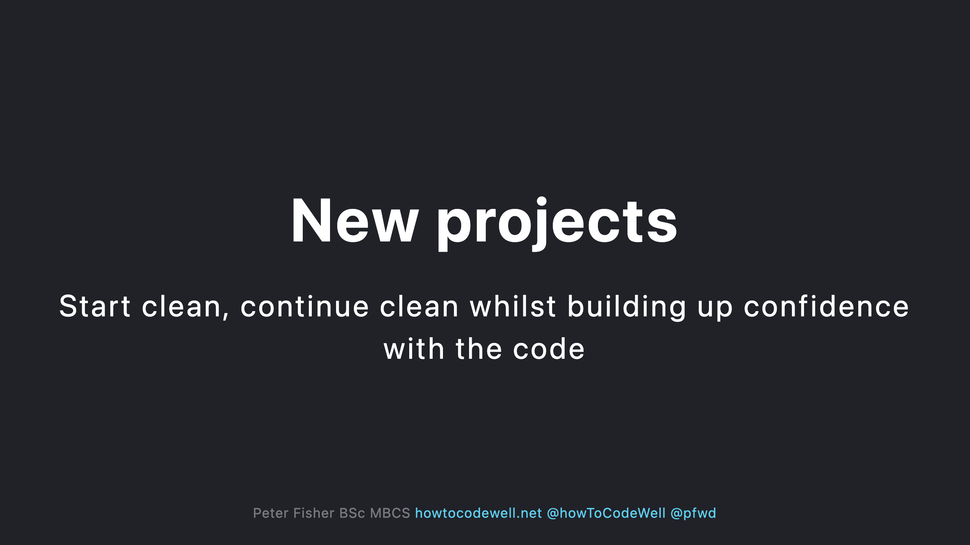
Notes:
- Be aware of known issues before 1st deployment - Gain visual feedback on what parts of code needs to be fixed - Spot potential gotchas in the new architecture - Create a CI that reports errors quickly - Ensure the team follows the same rules - Move quickly whilst building stability

Slide 12
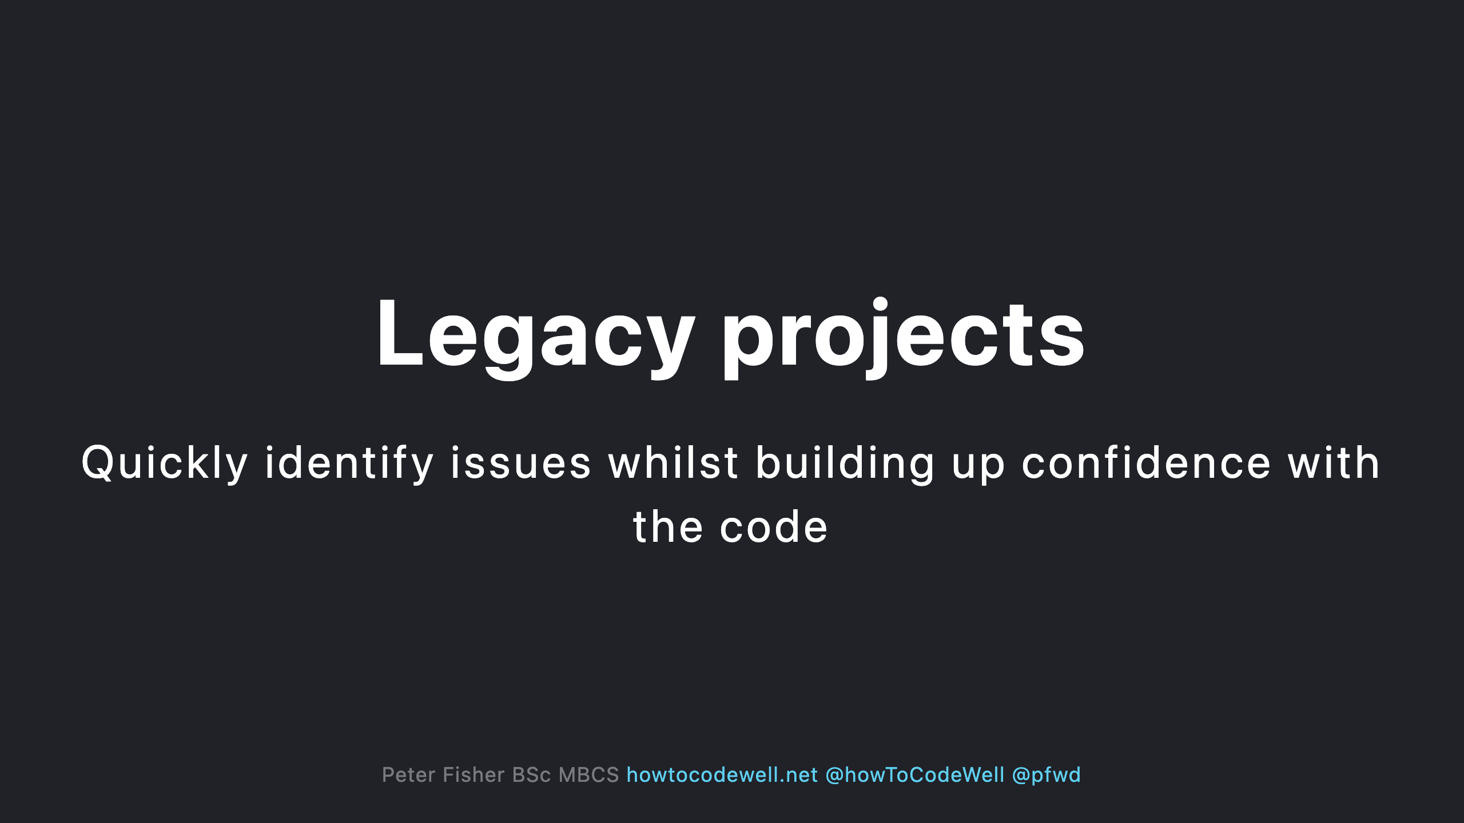
Notes:
- Be aware of known issues before deployment - Clean up existing code smells - Enforce coding standards and rules in the CI - Standardize the codebase - Make the devs happy

Slide 13
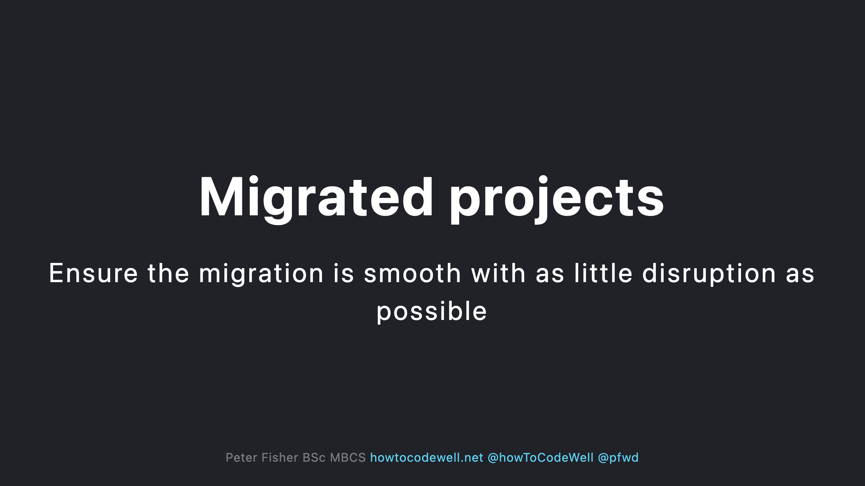
Notes:
- End users should only experience positive changes - Be aware of the risky areas - Keep data secure

Slide 14
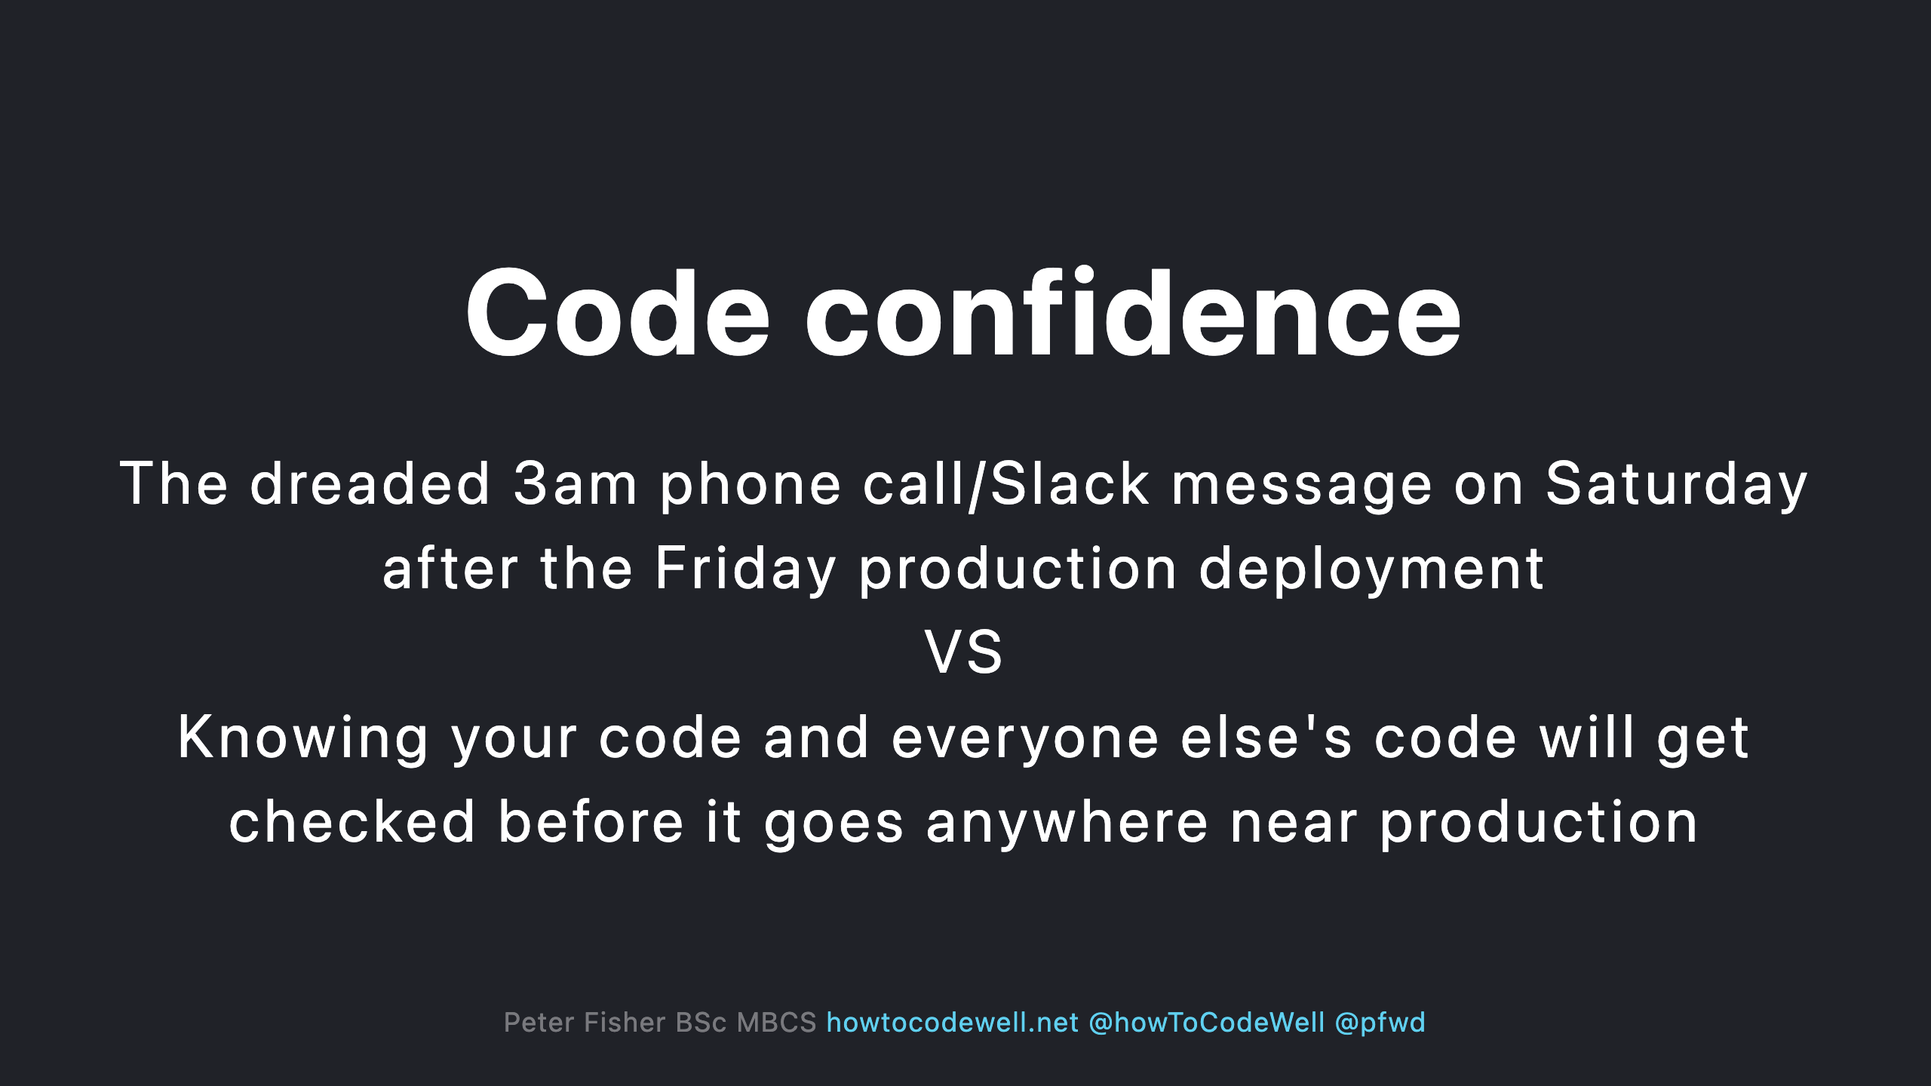

Slide 15
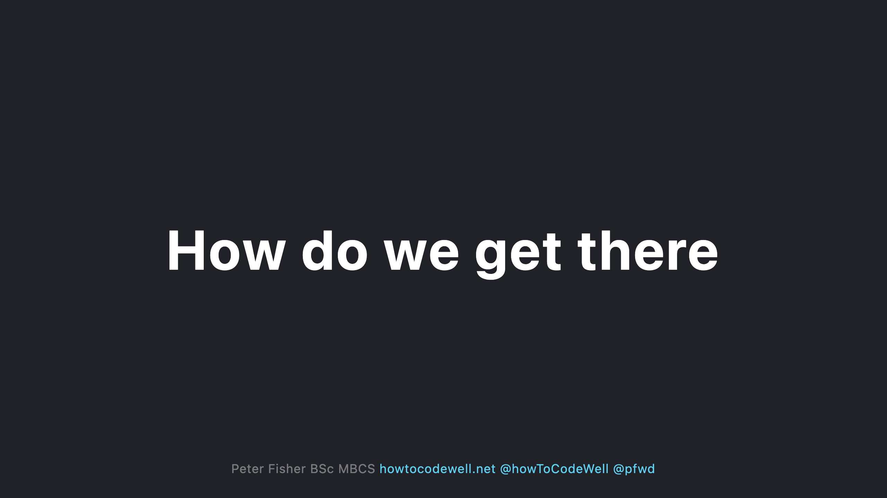

Slide 16
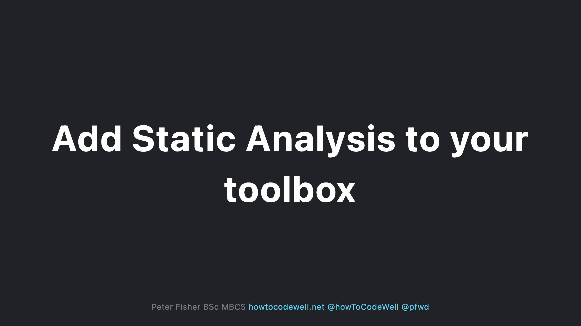
Notes:
- Static Analysis is just one of many tools - PHP mess detection - PHP code sniffers - PHP unit tests

Slide 17
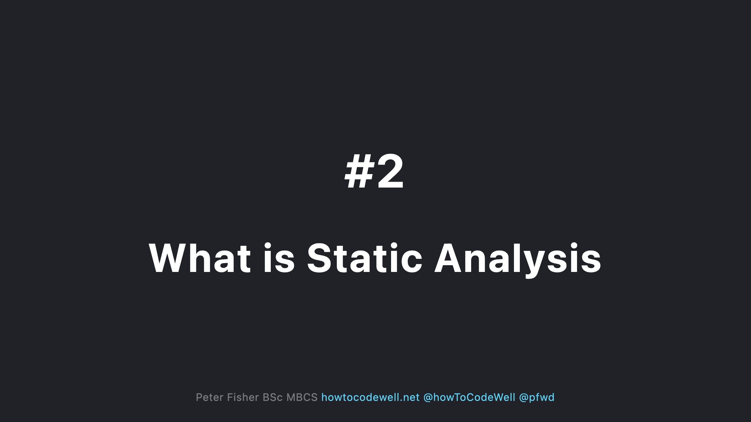

Slide 18
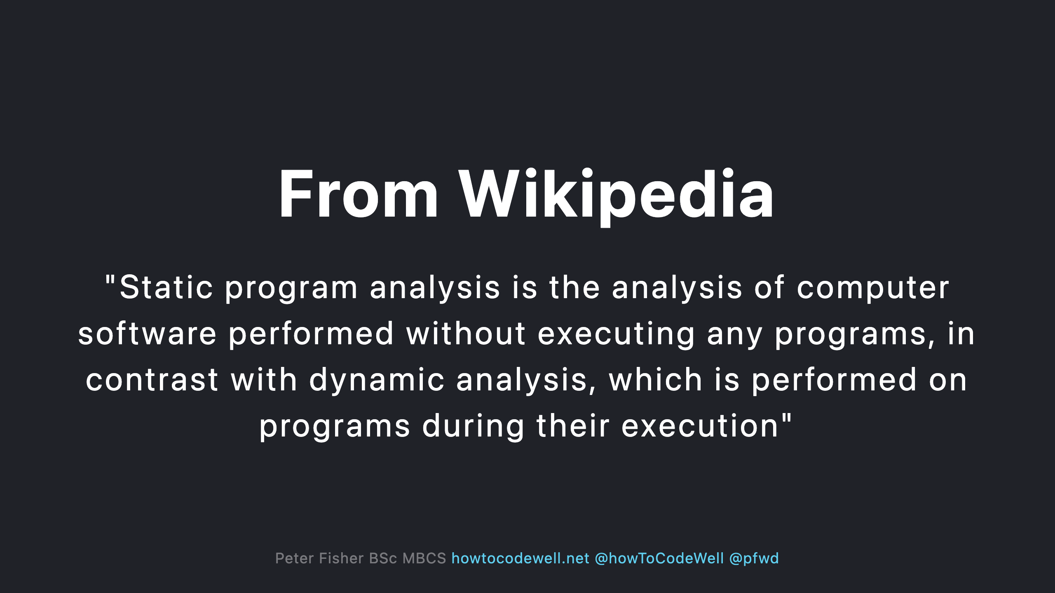

Slide 19
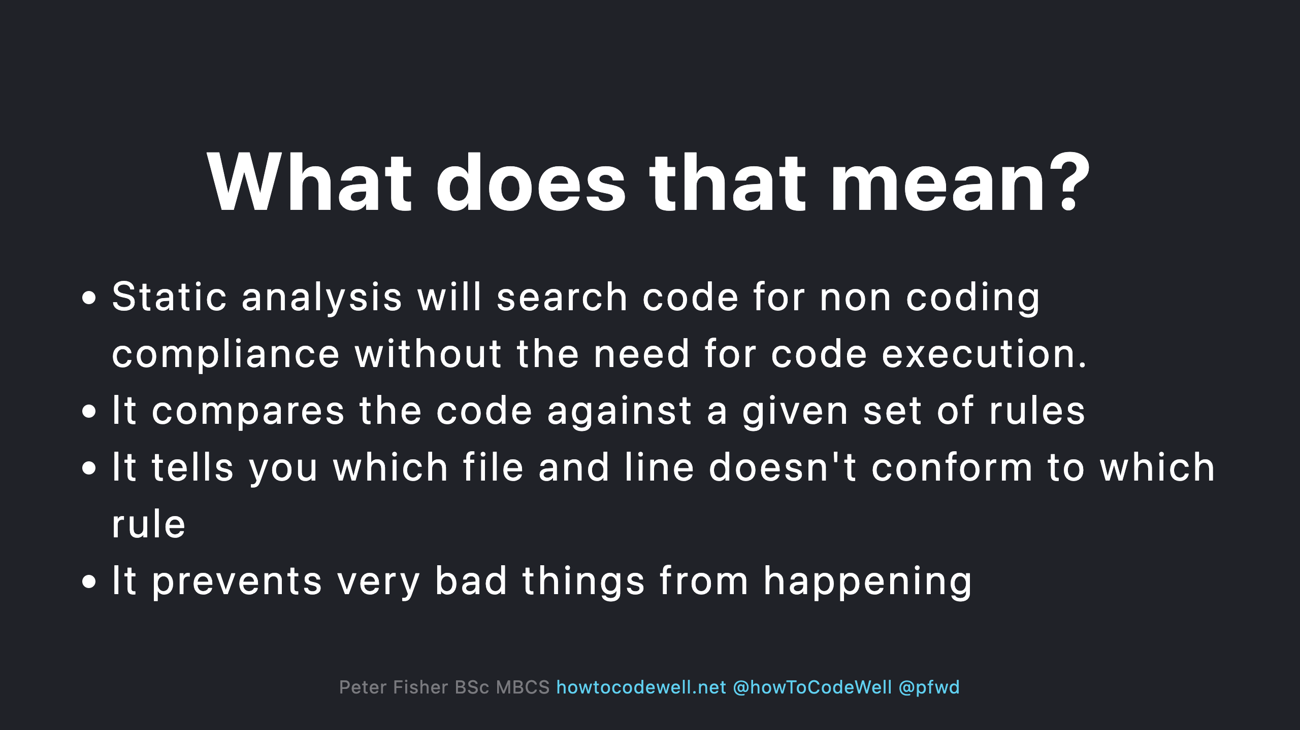

Slide 20
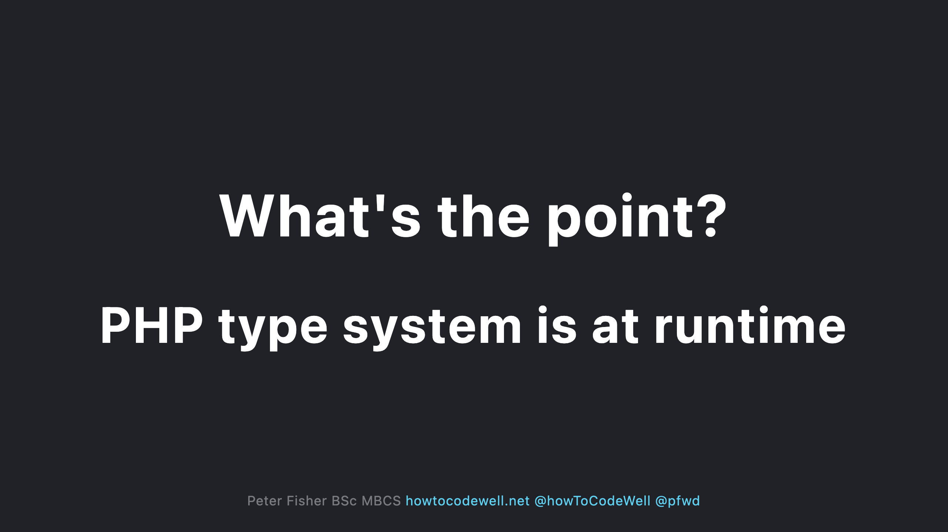
Notes:
Code needs to run to the point of failure before the bug is discovered The code needs to run to see the errors

Slide 21
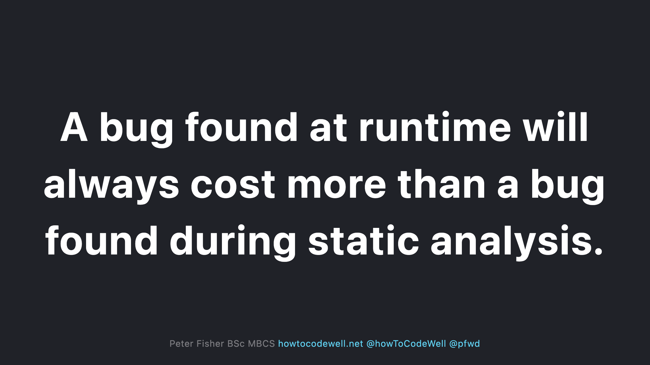

Slide 22
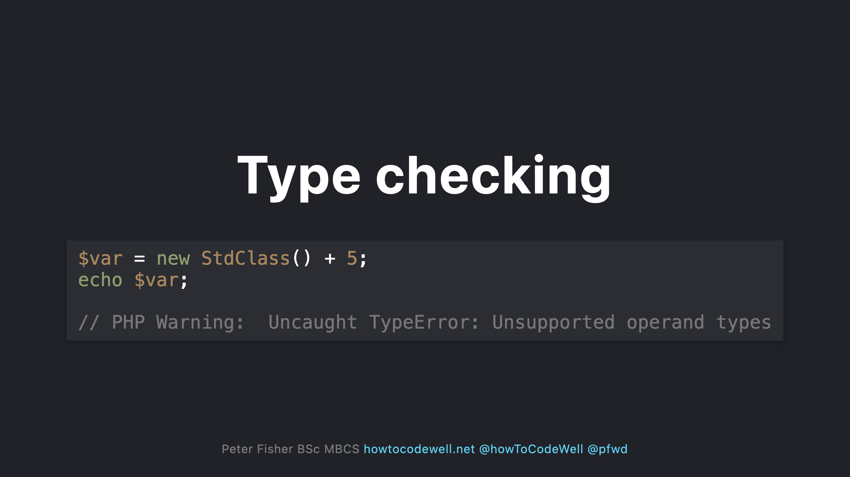

Slide 23
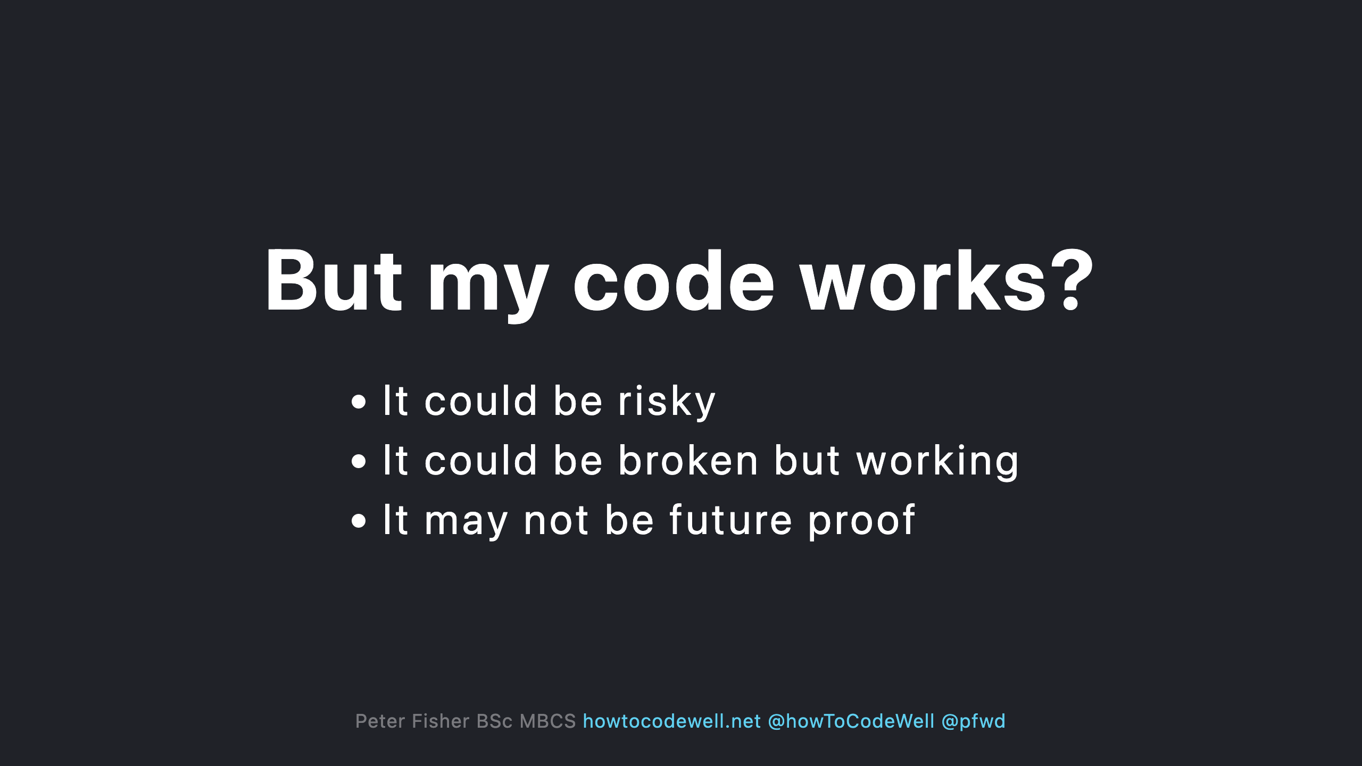

Slide 24
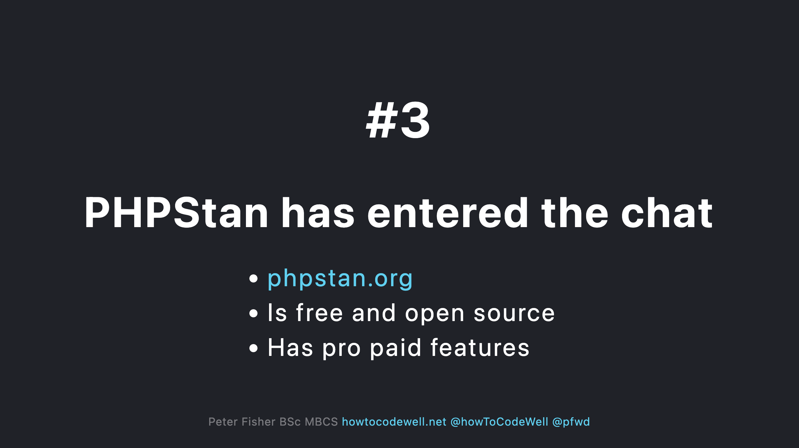

Slide 25
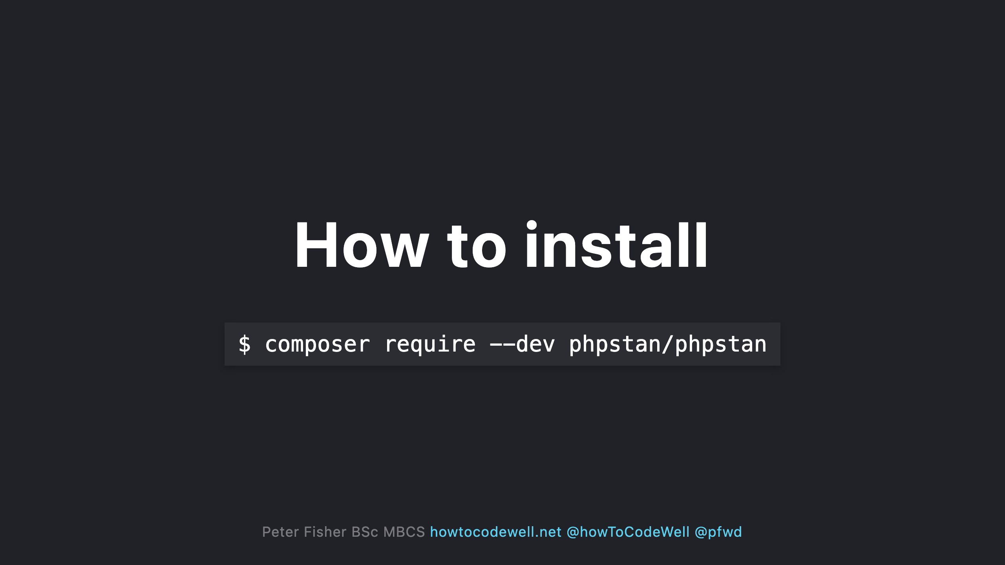
Notes:
- PHPStan should be a dev dependency. Don't install it in production

Slide 26
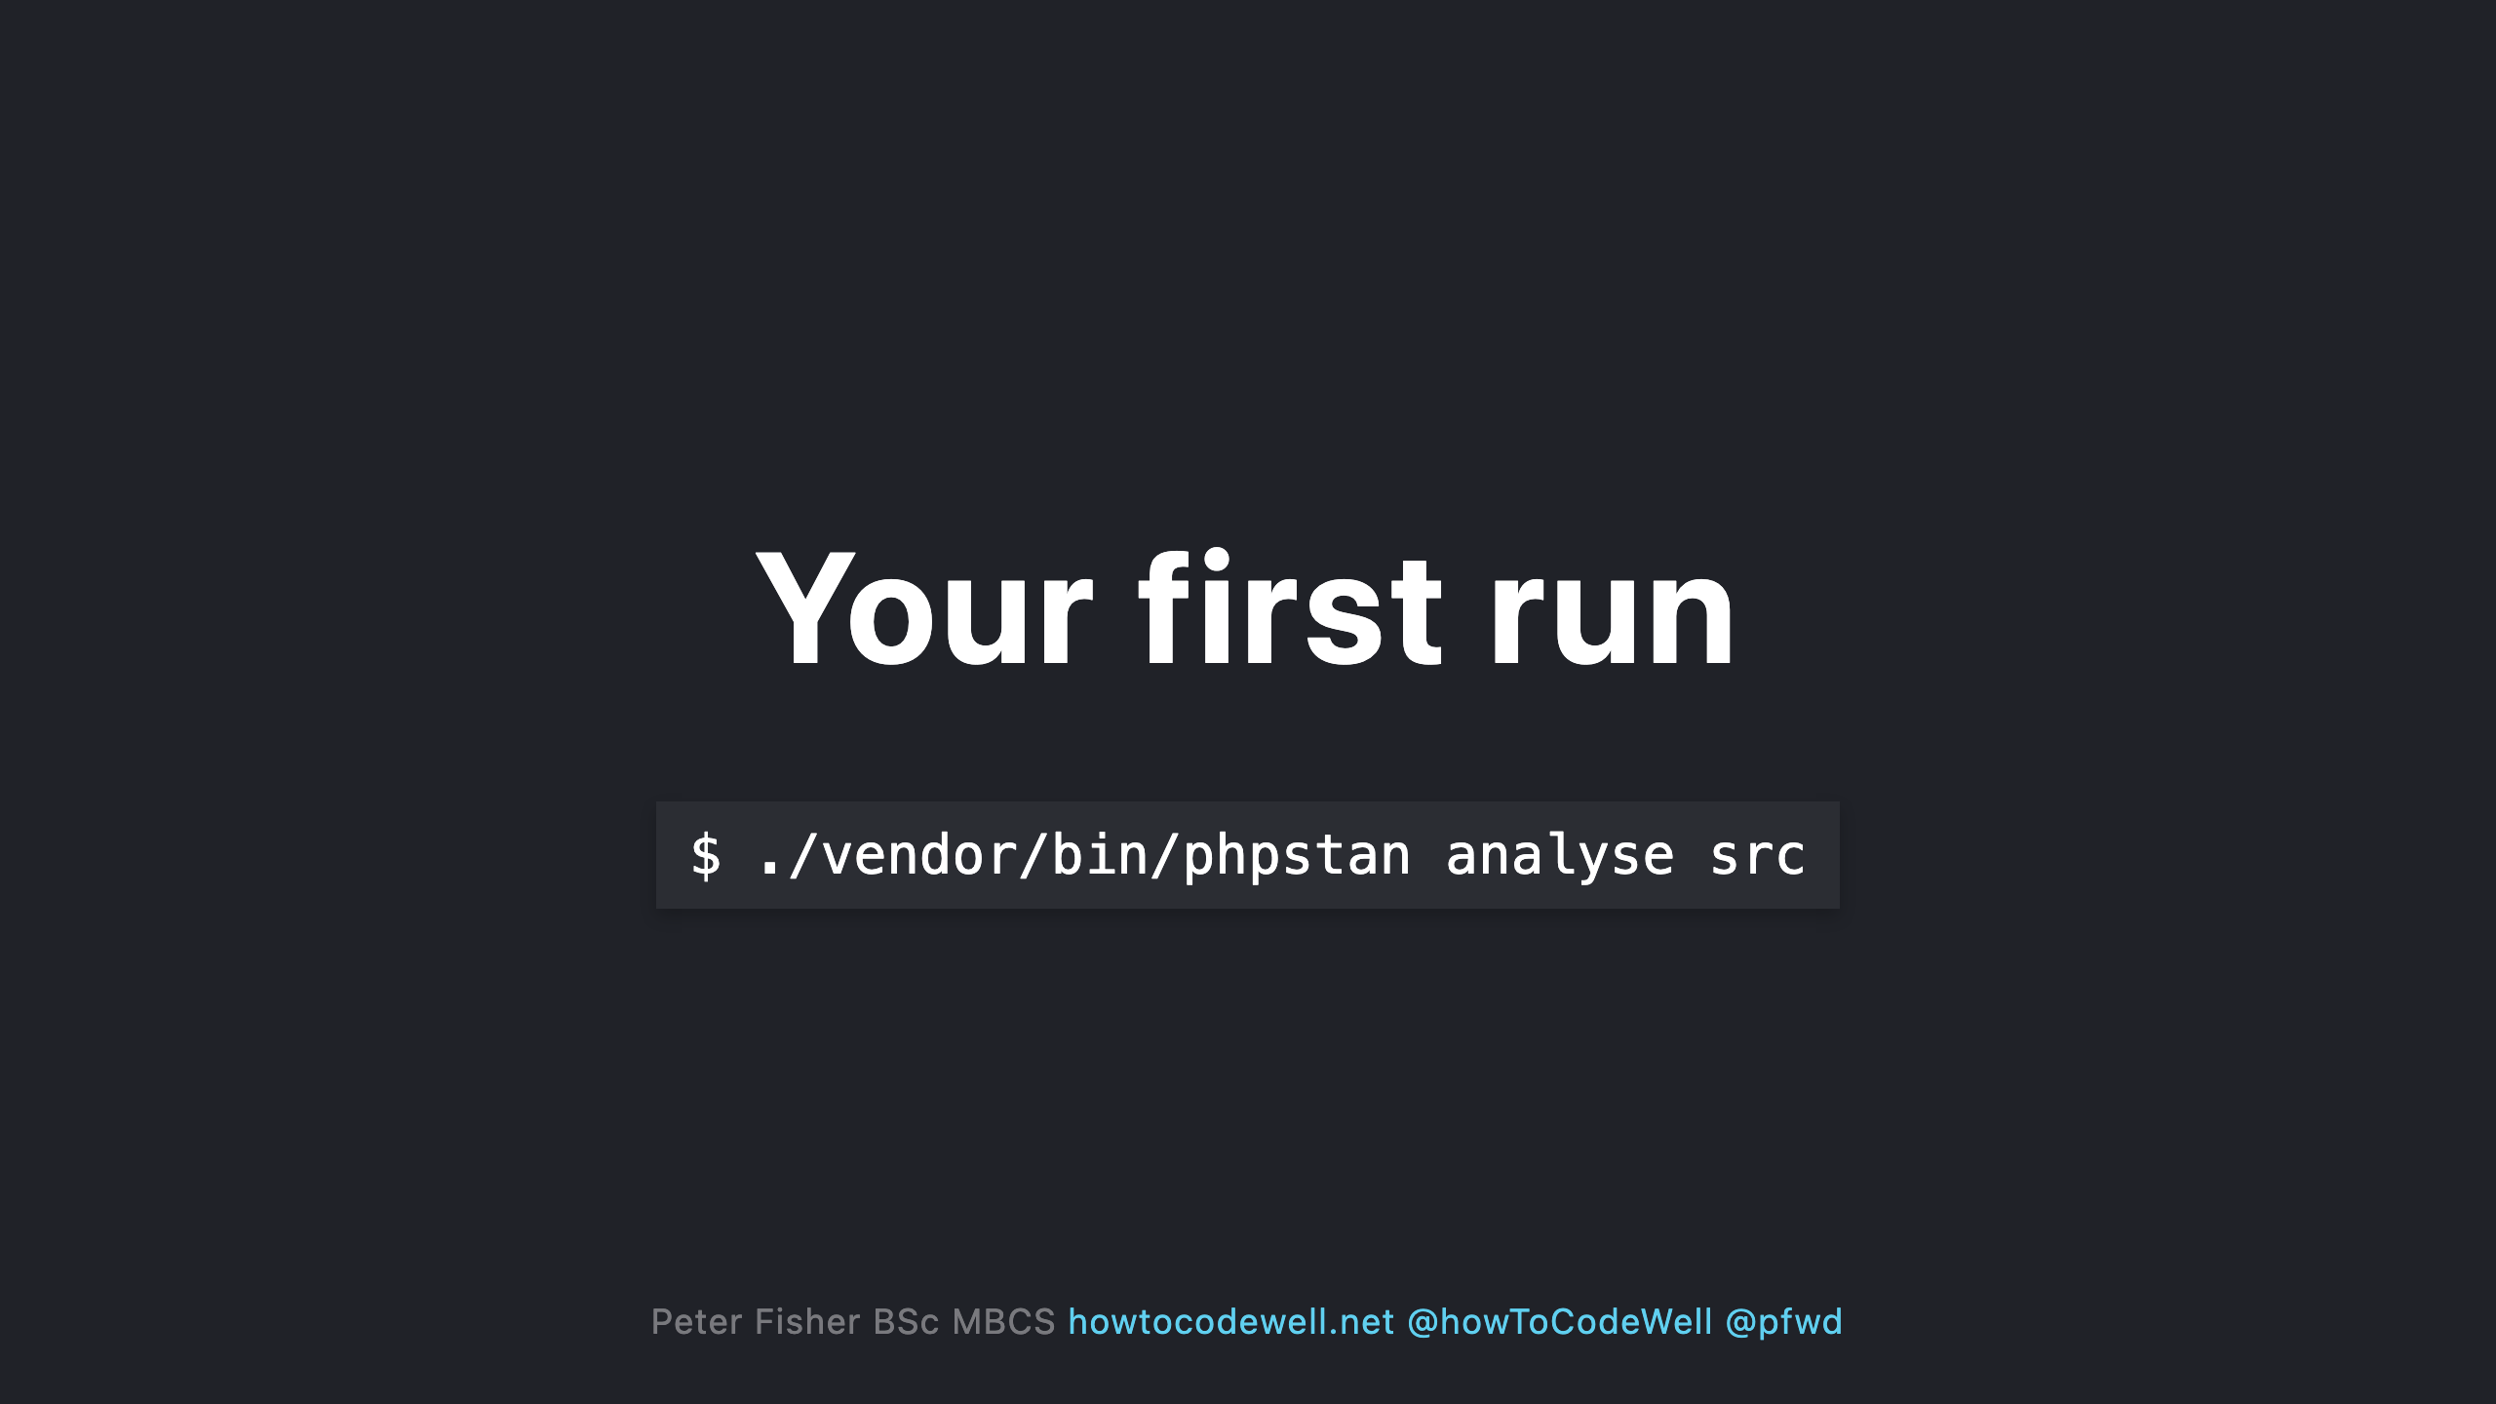
Notes:
- You can provide multiple folders or files to analyse in the command

Slide 27
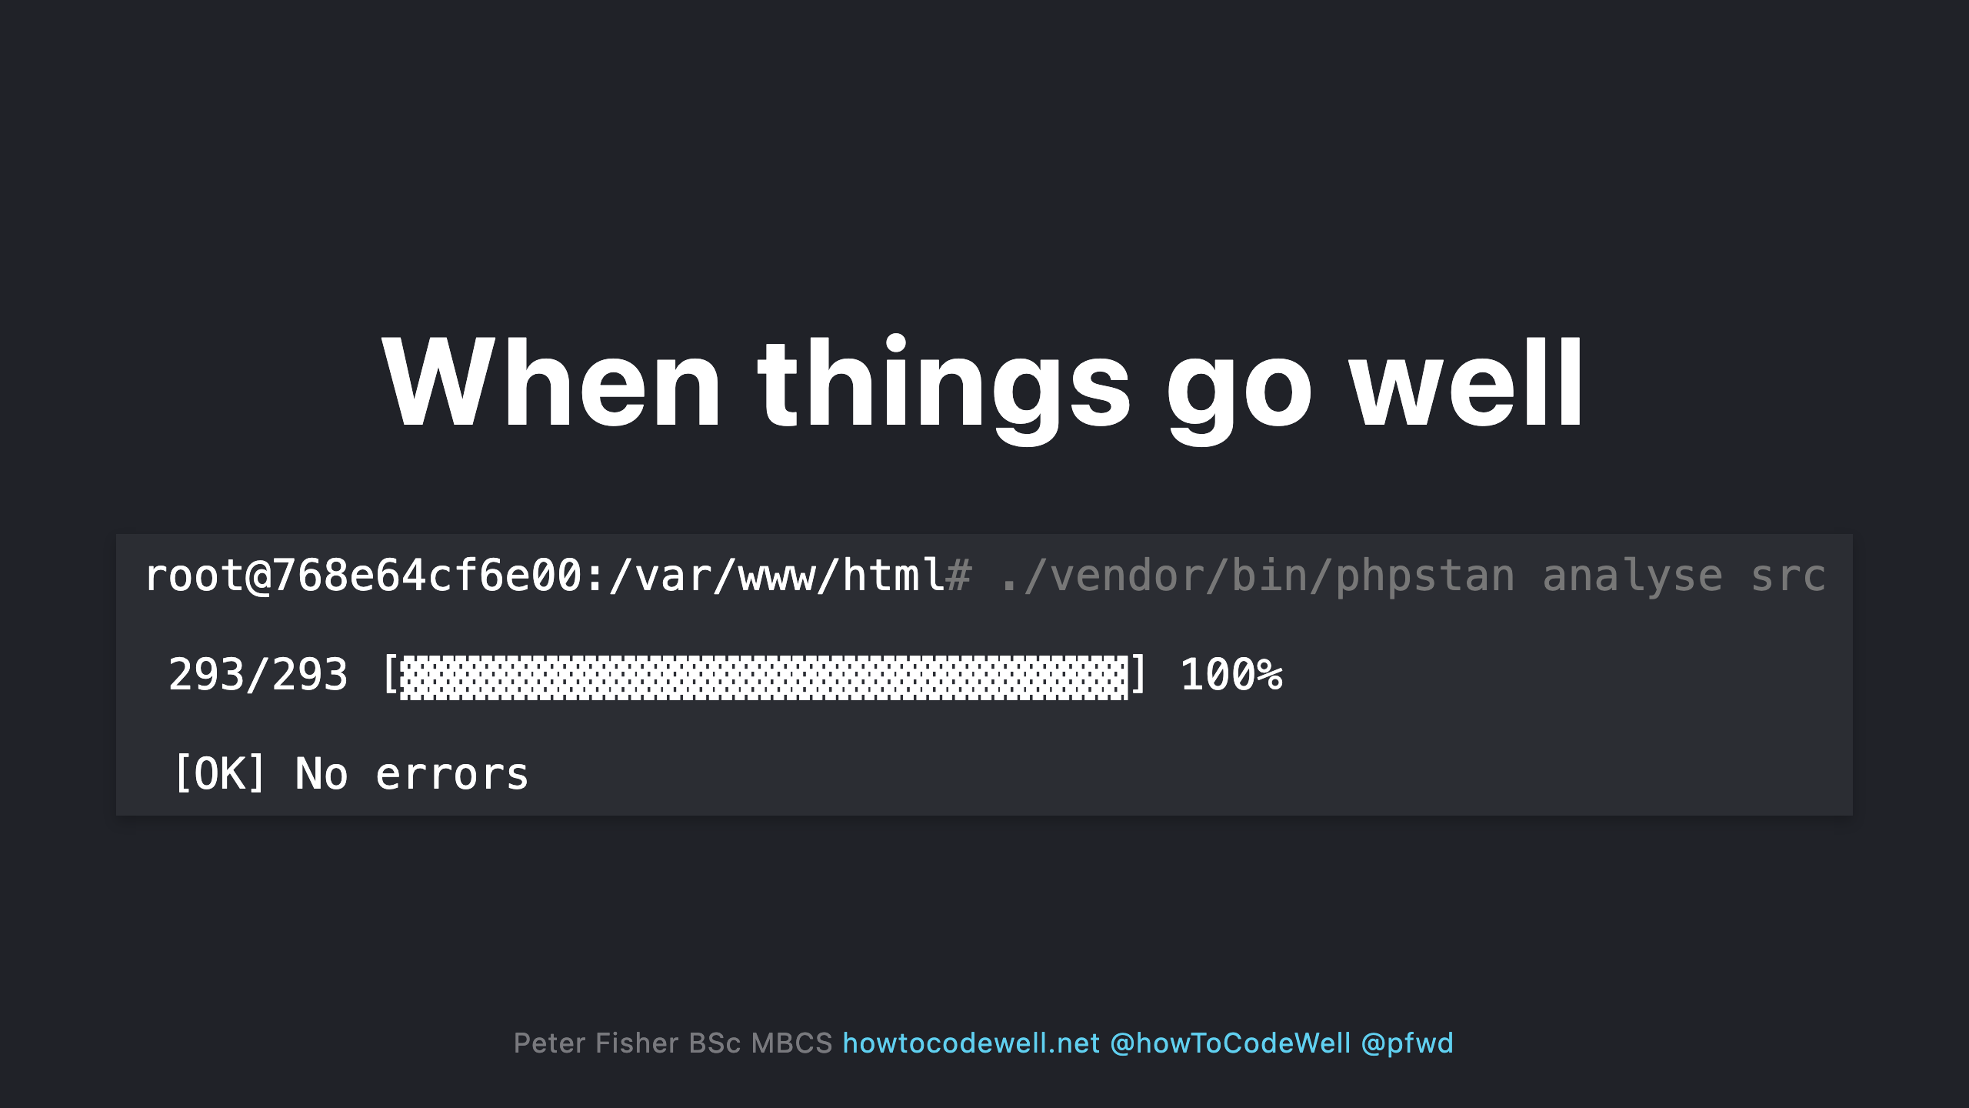

Slide 28
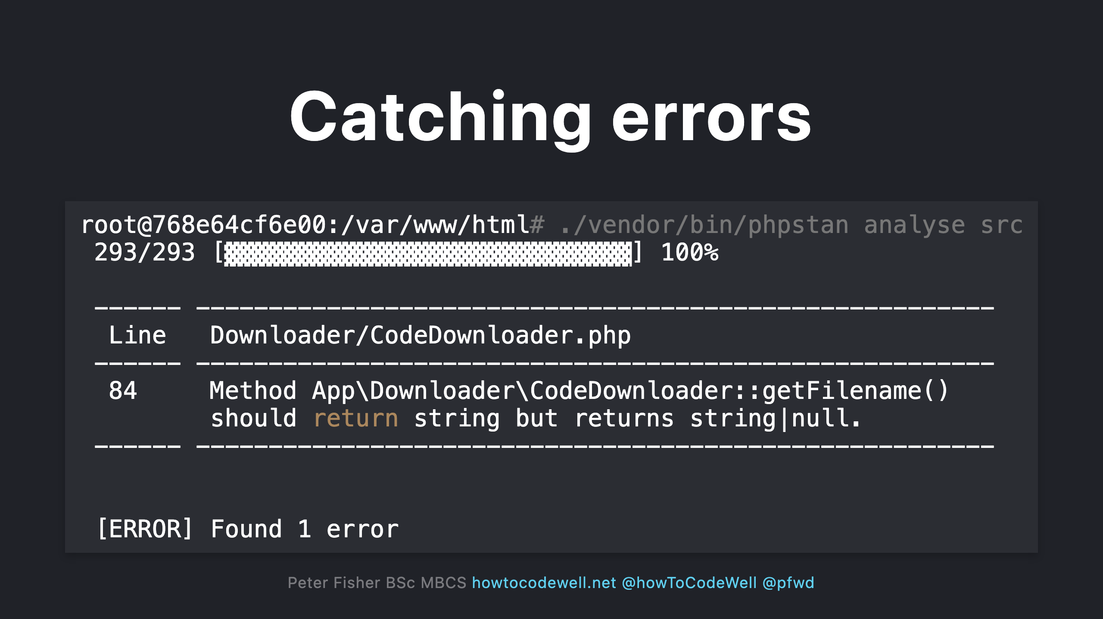

Slide 29
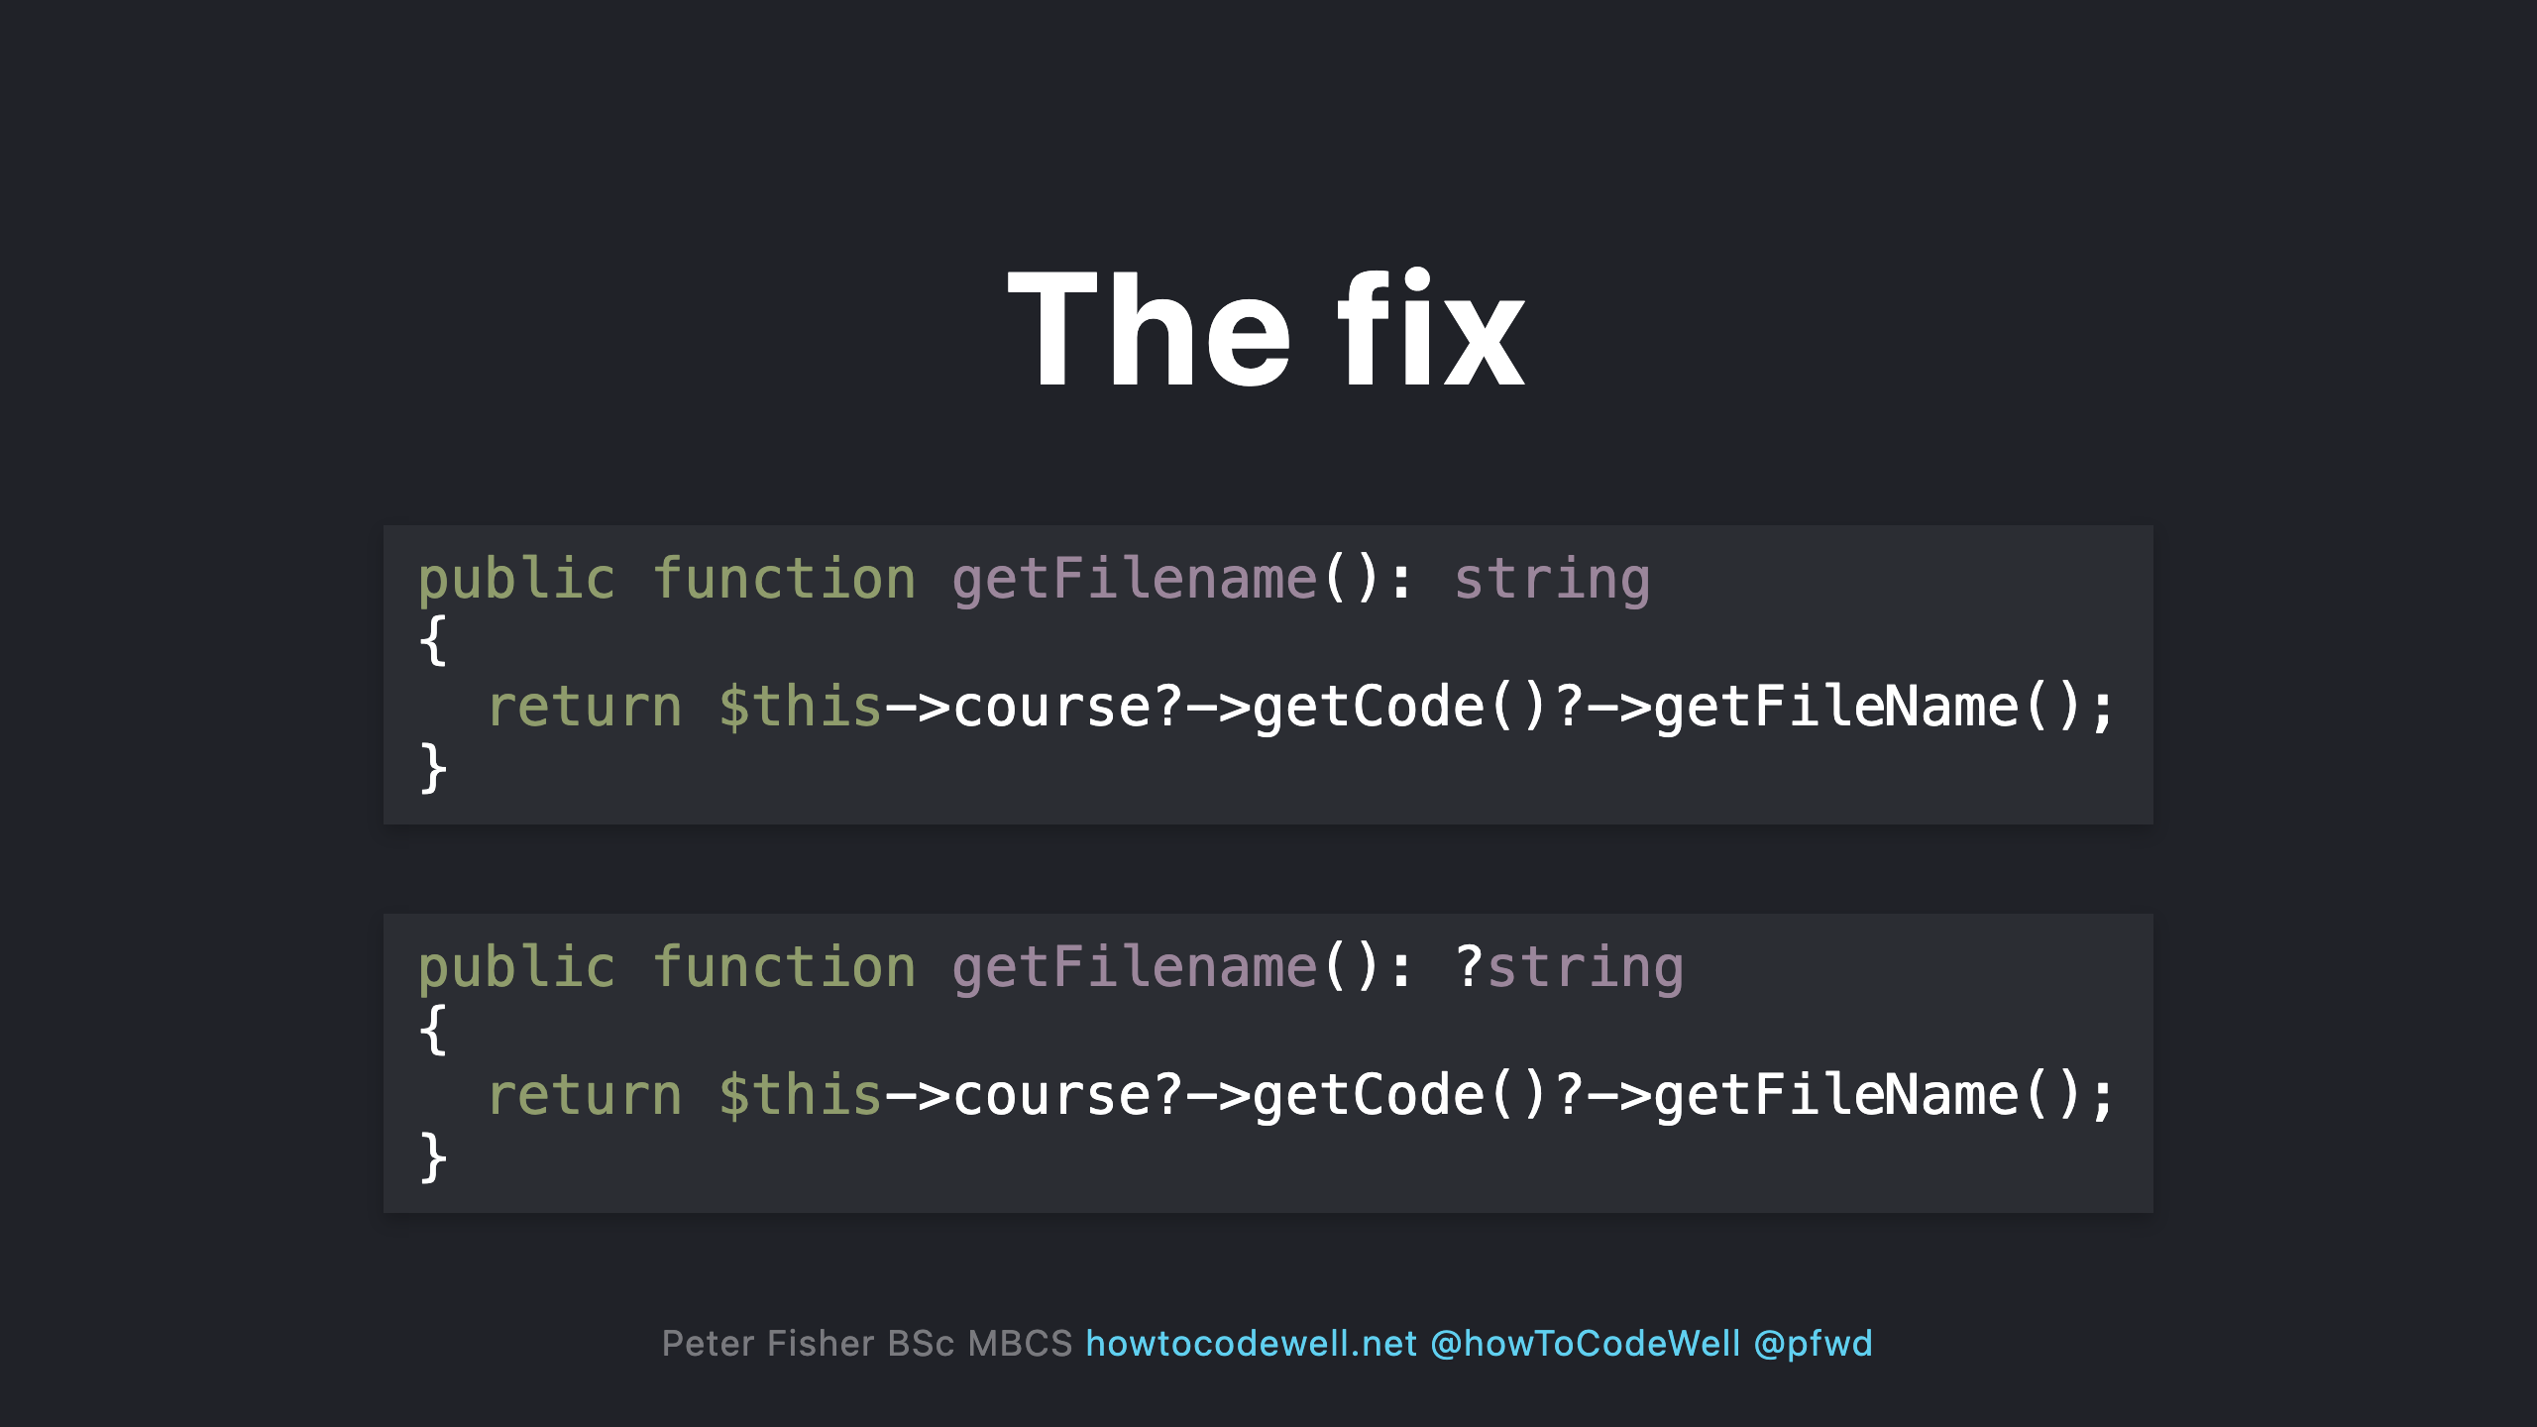
Notes:
- Updating the return type to allow for nullable values (:?string)

Slide 30
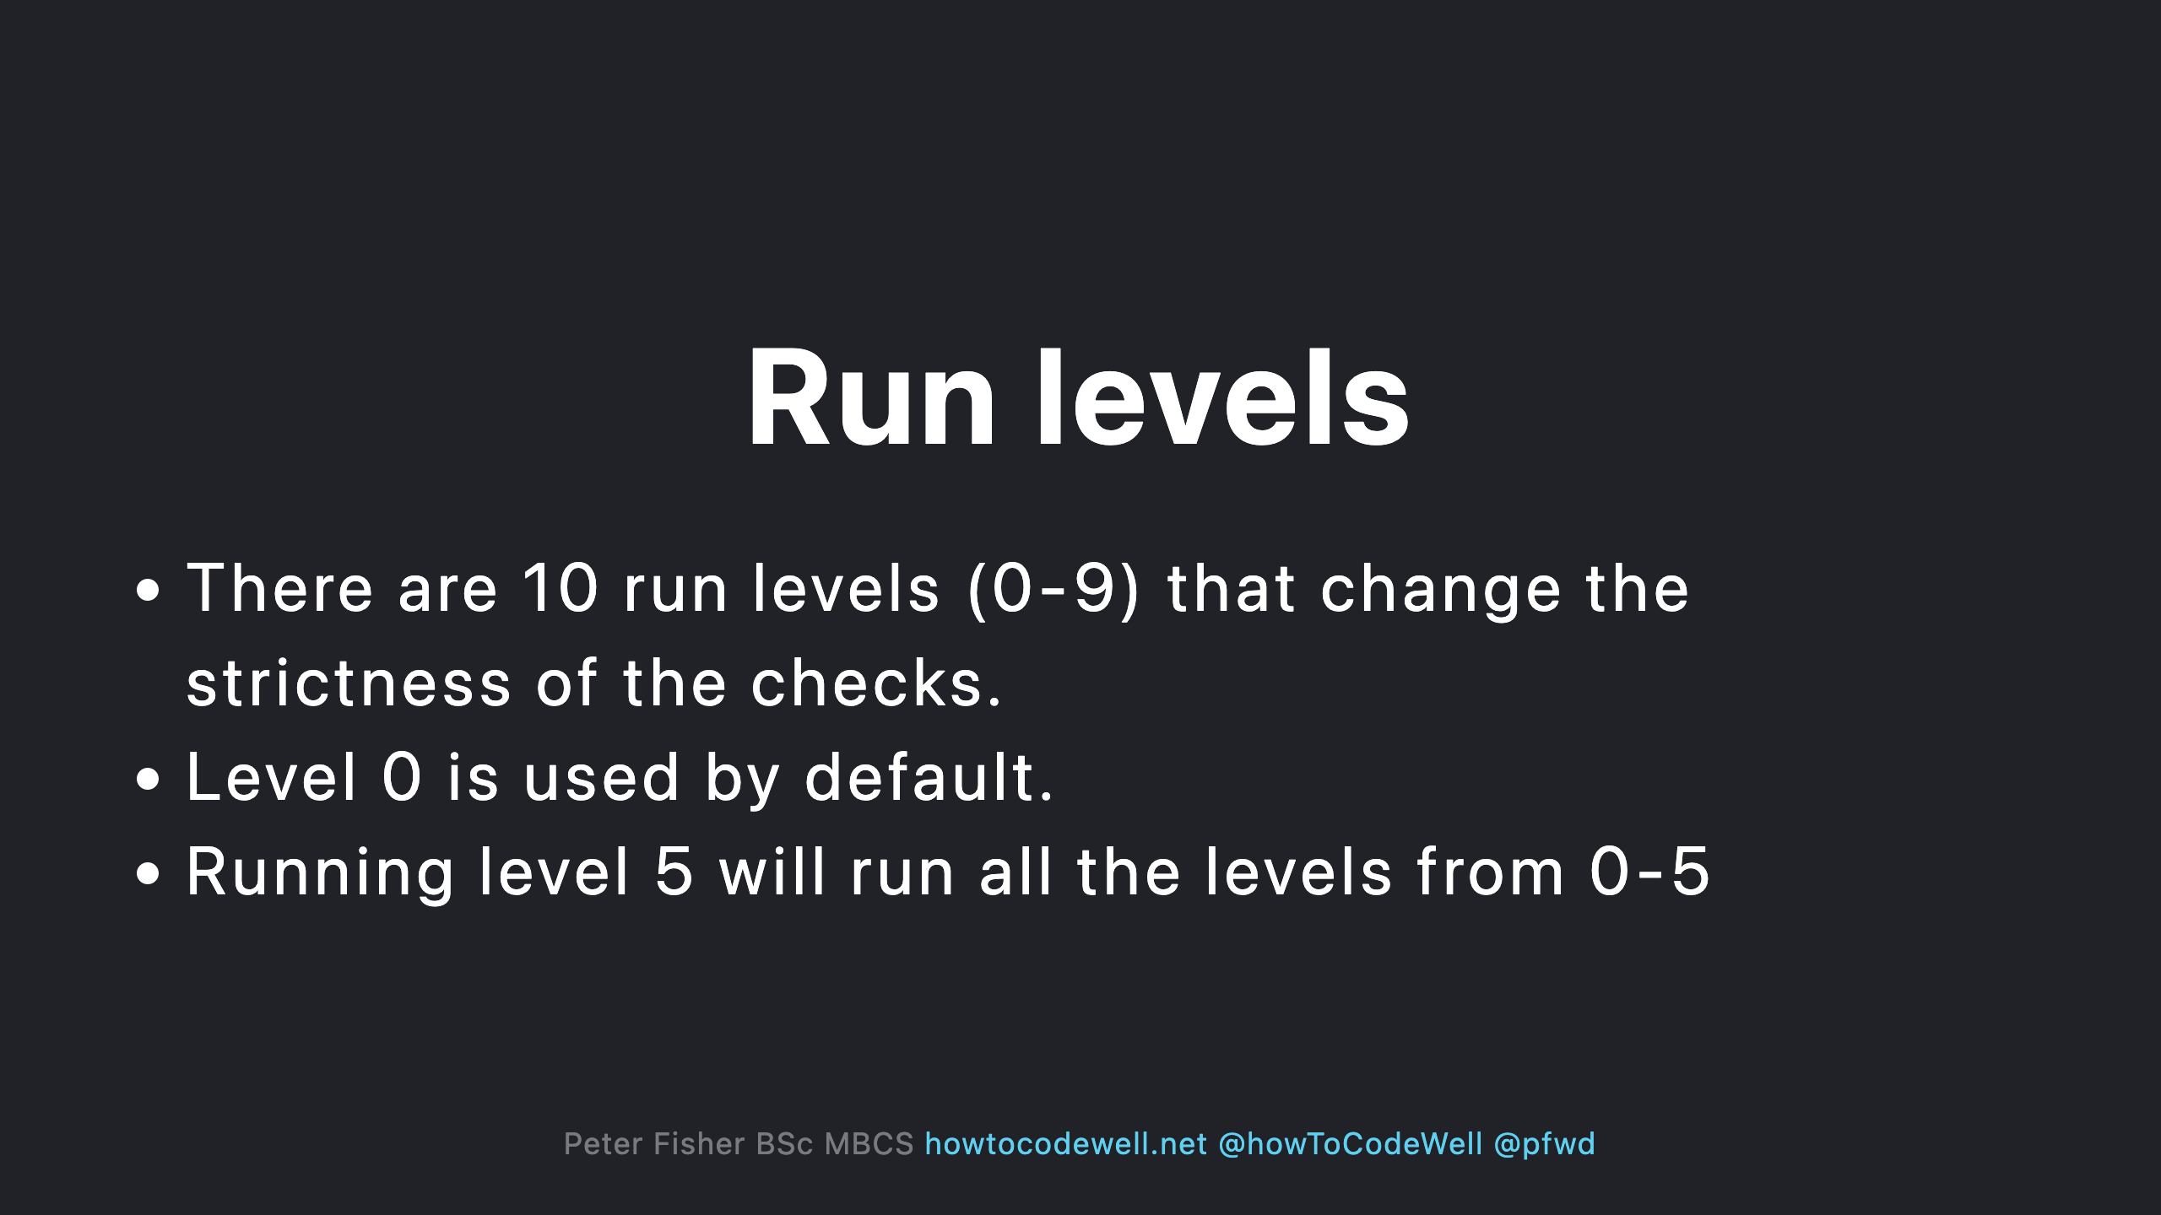
Notes:
Level 0 - Basic checks - unknown classes - unknown functions - unknown methods called on $this - wrong number of arguments passed to those methods and functions - always undefined variables Level 1 - possibly undefined variables - unknown magic methods and properties on classes with __call and __get Level 2 - unknown methods checked on all expressions (not just $this) - validating PHPDocs Level 3 - Return types - types assigned to properties Level 4 - Dead code checking - always false instanceof and other type checks - Unreachable code after Level 5 - Checking types of arguments passed to methods and functions Level 6 - Missing typehints Level 7 - Report partially wrong union types Level 8 - Report calling methods and accessing properties on nullable types Level 9 - 9 be strict about the mixed type

Slide 31
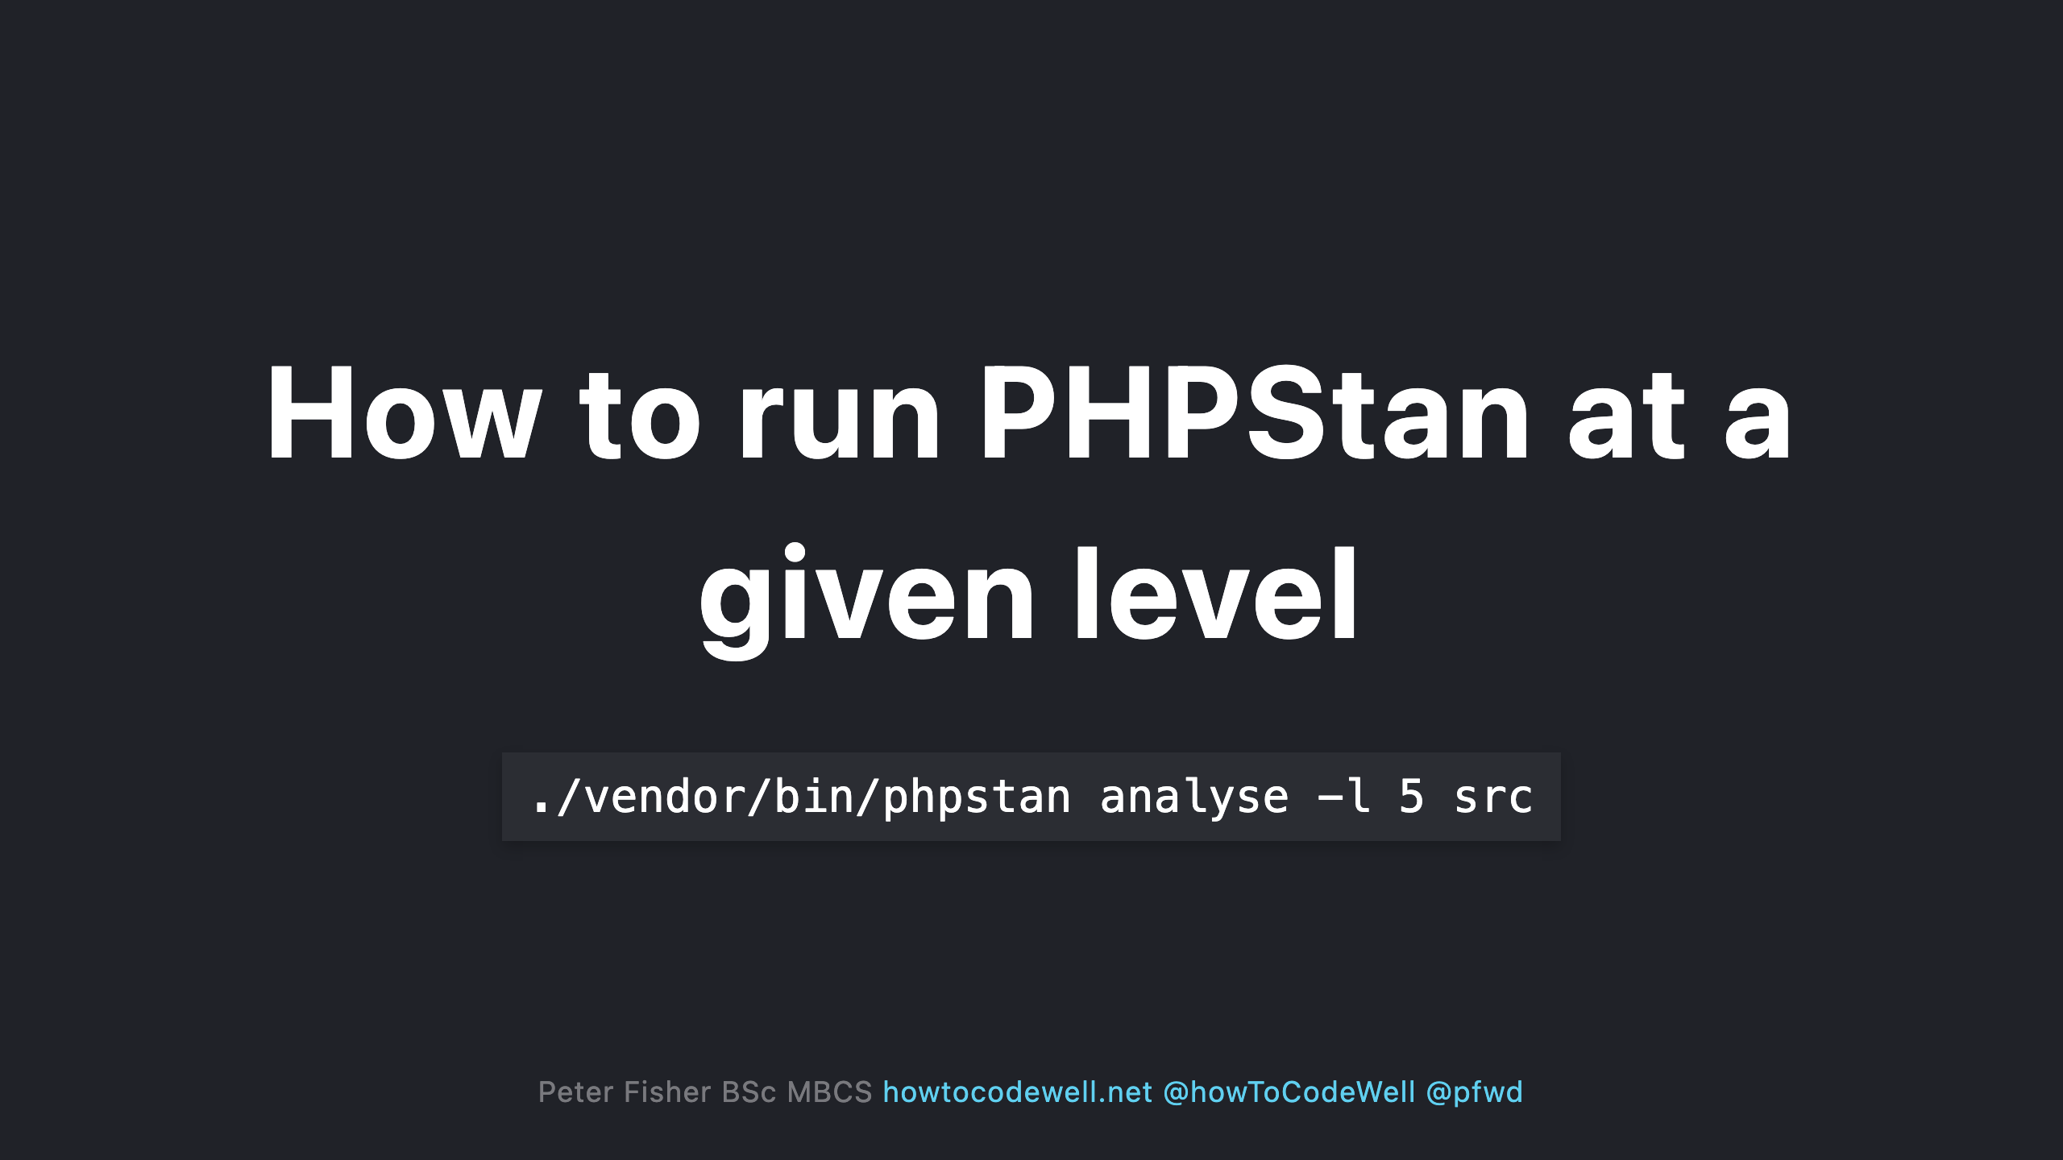

Slide 32
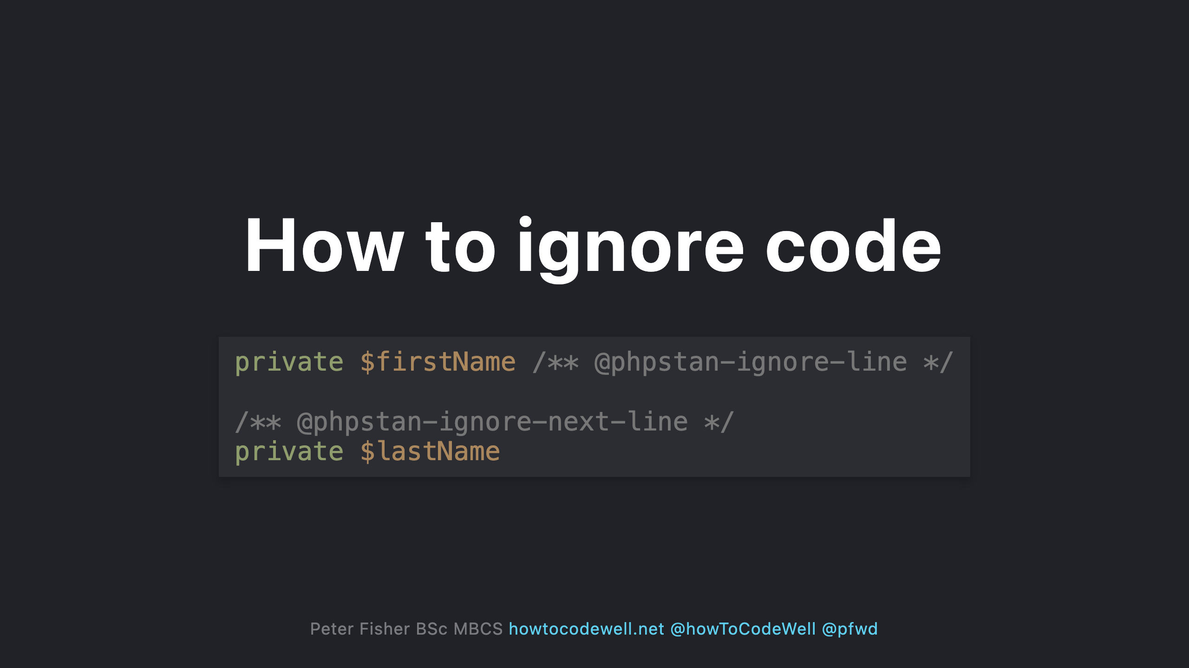
Notes:
- This would normally error as both $firstName and $lastName have no data types - You can also use two forward slashes (//)

Slide 33
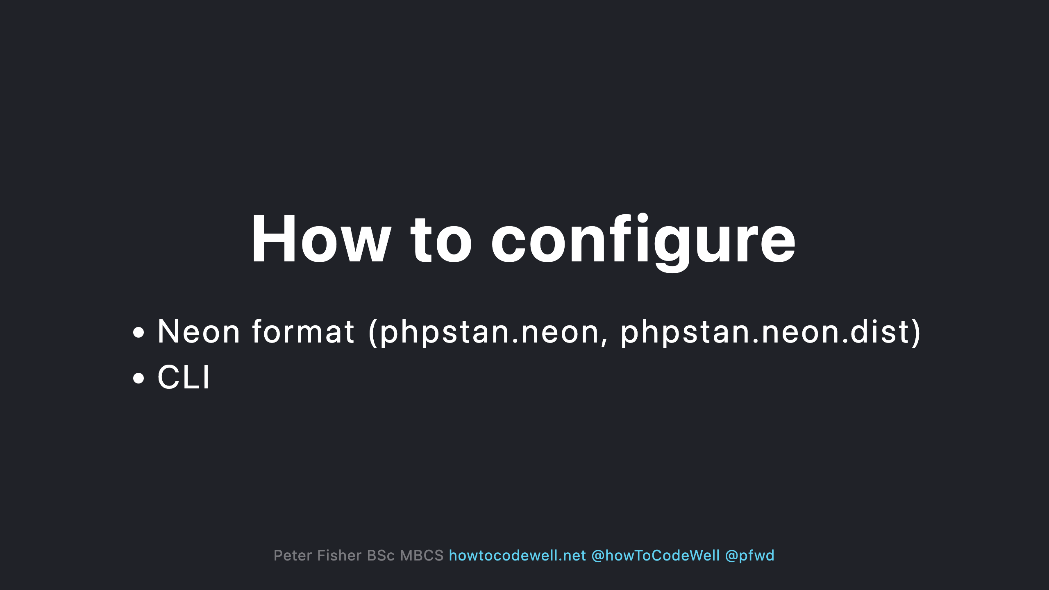

Slide 34
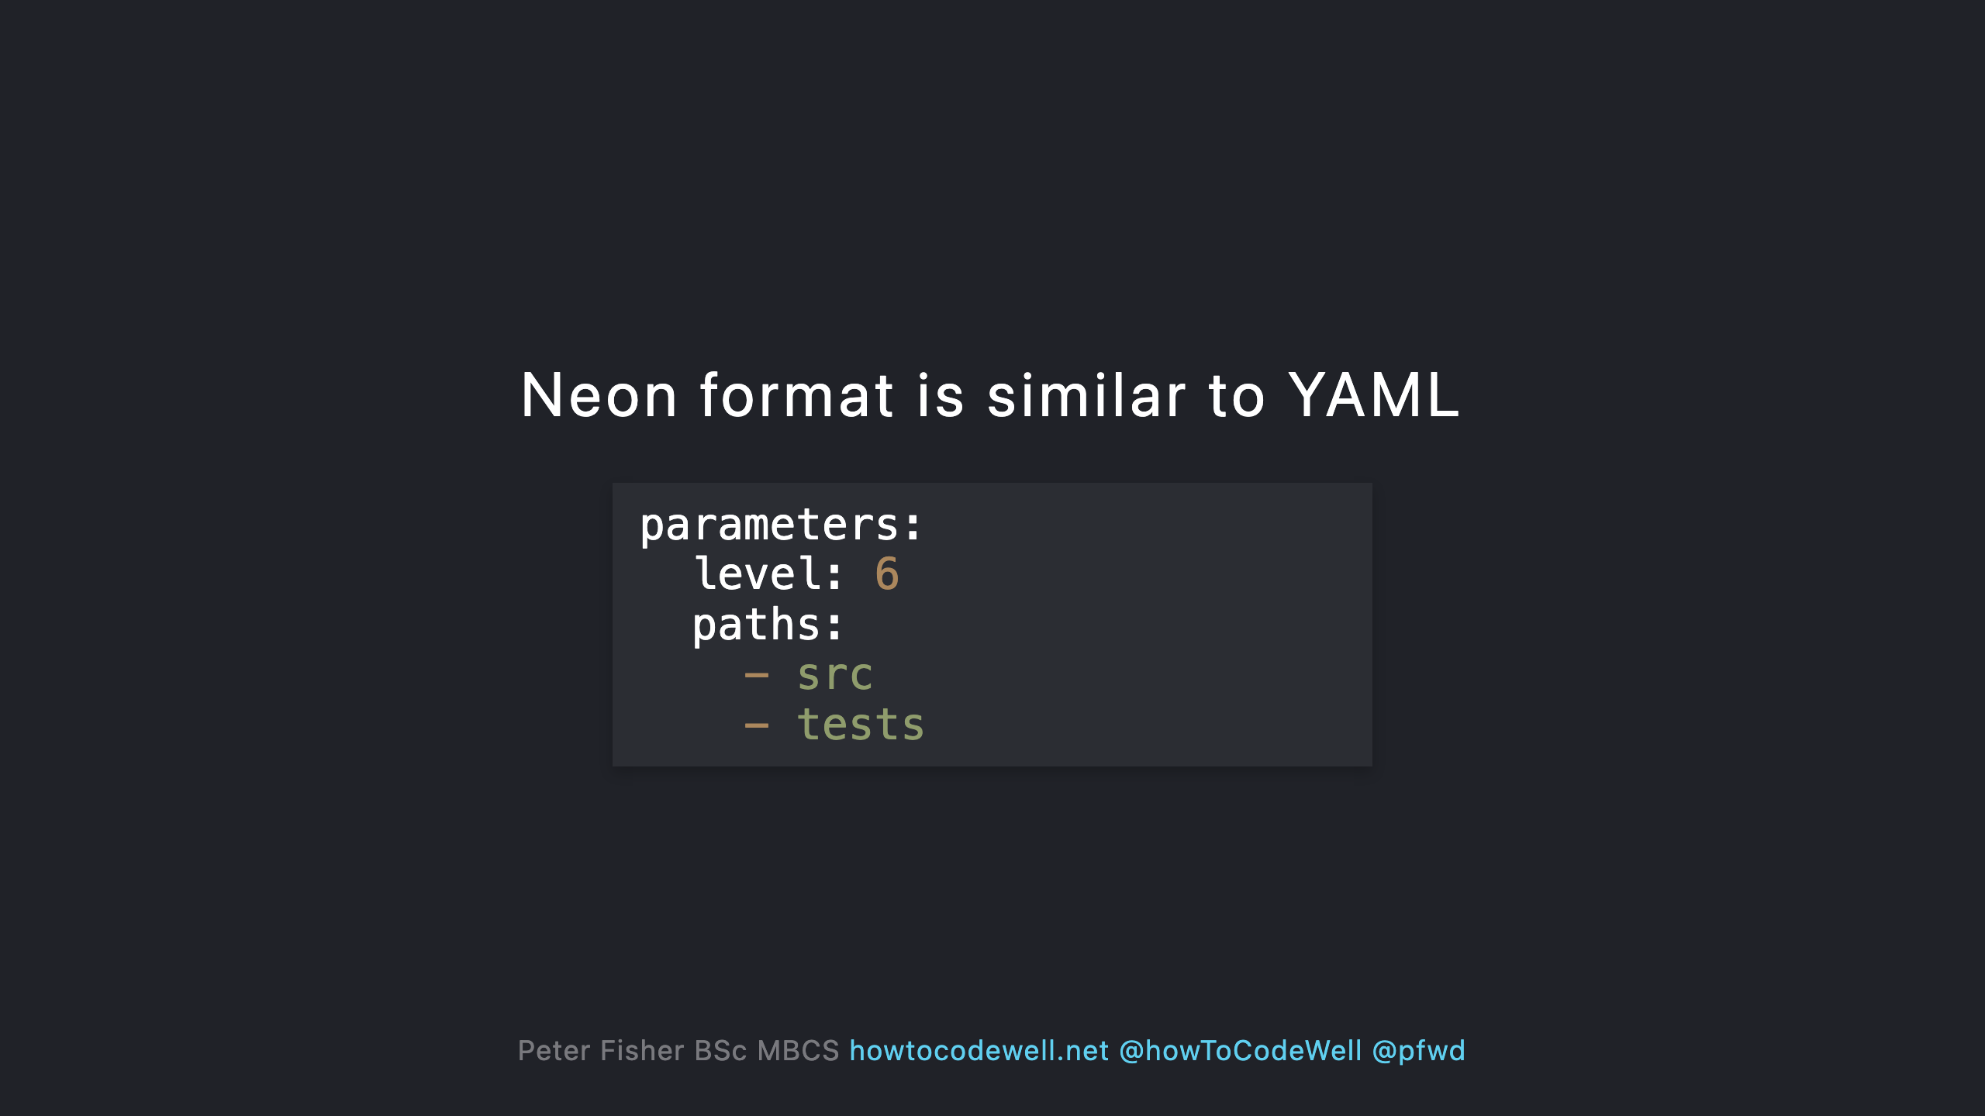

Slide 35
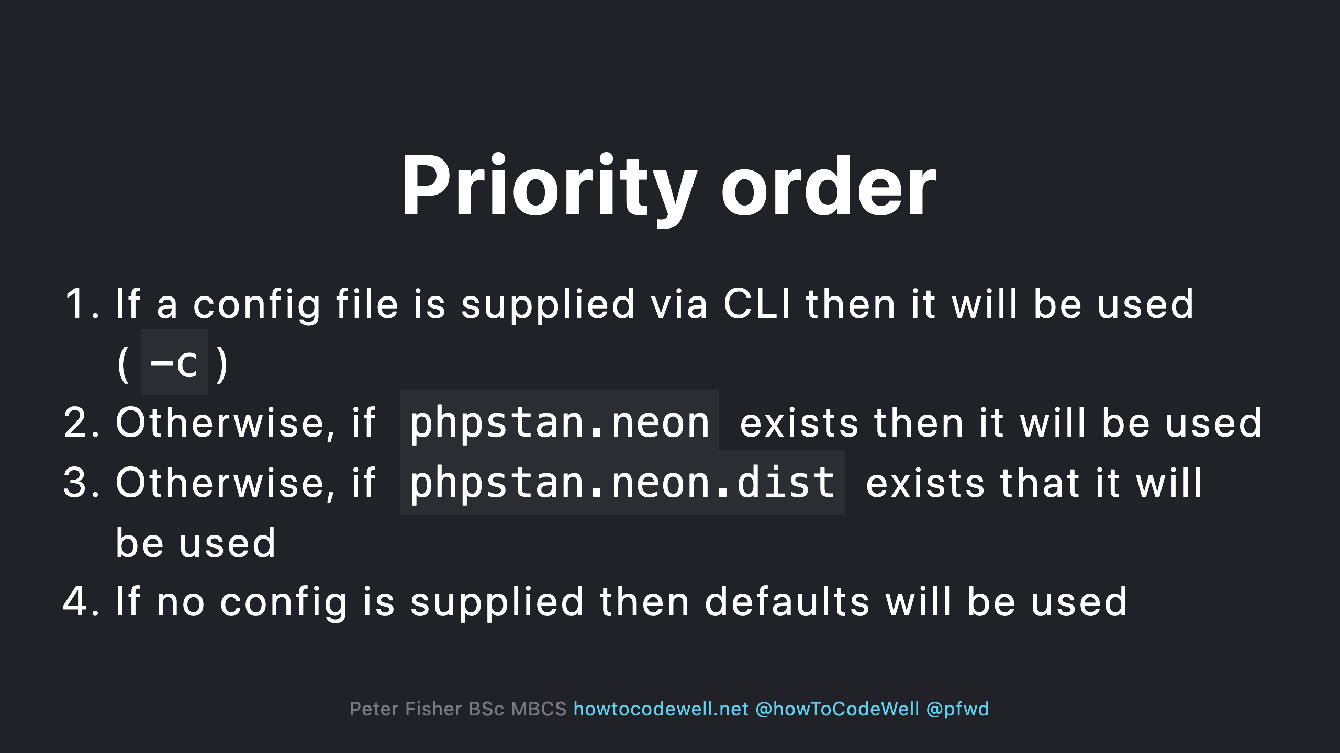

Slide 36
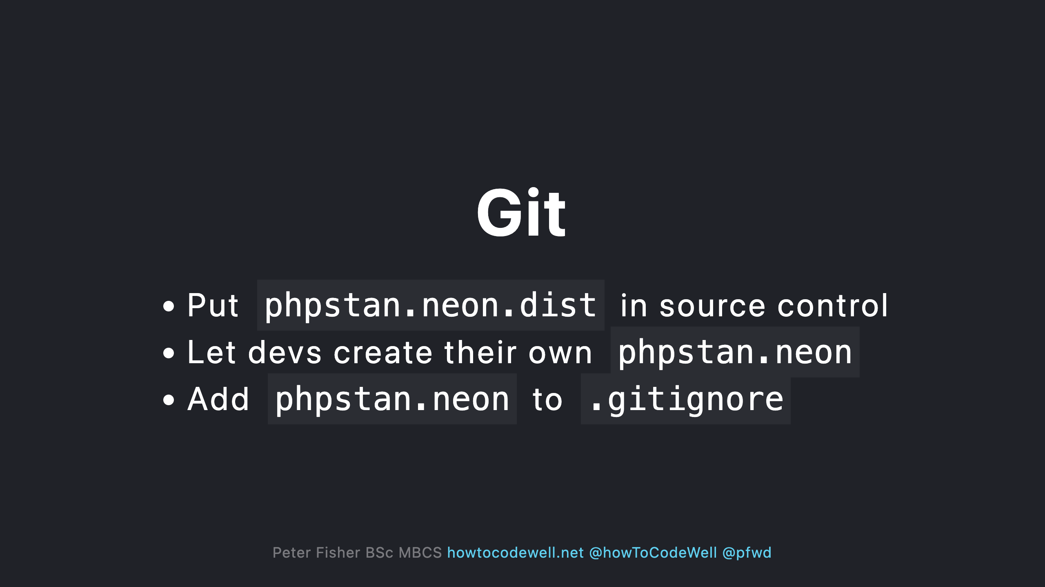

Slide 37
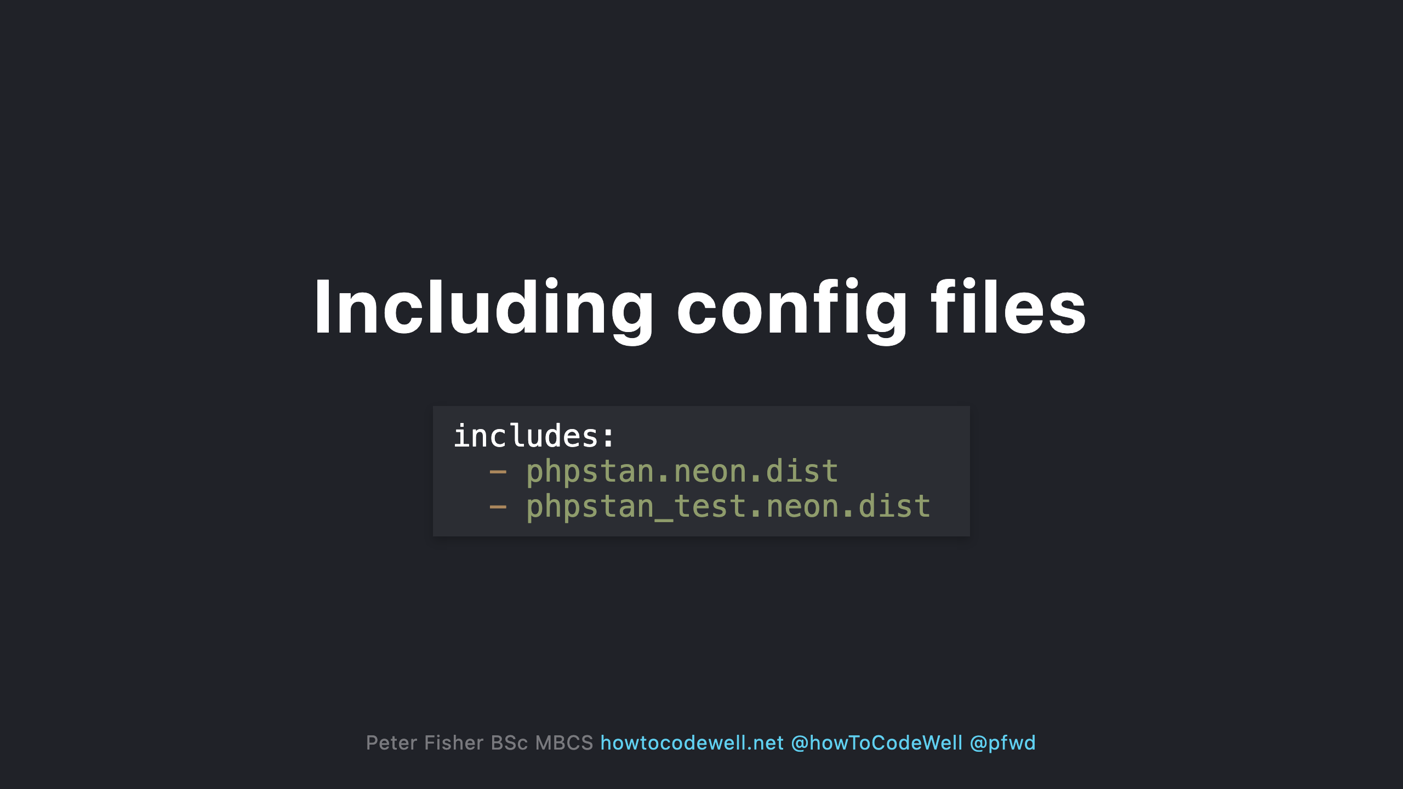

Slide 38
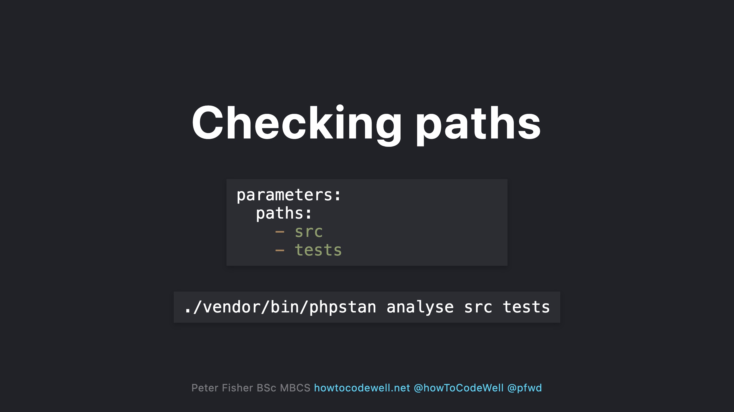

Slide 39
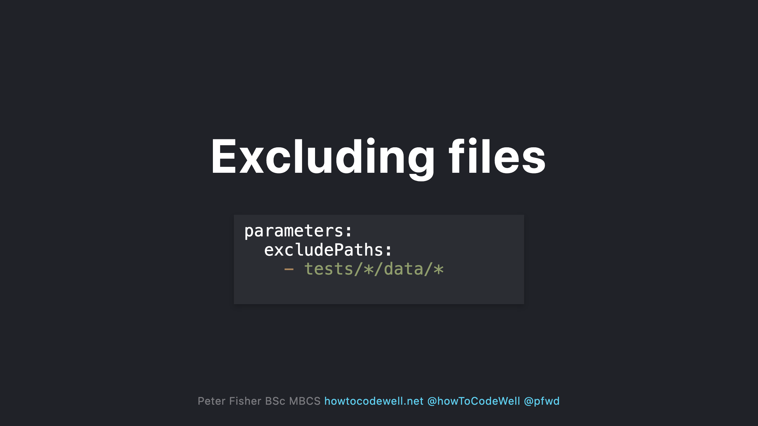

Slide 40
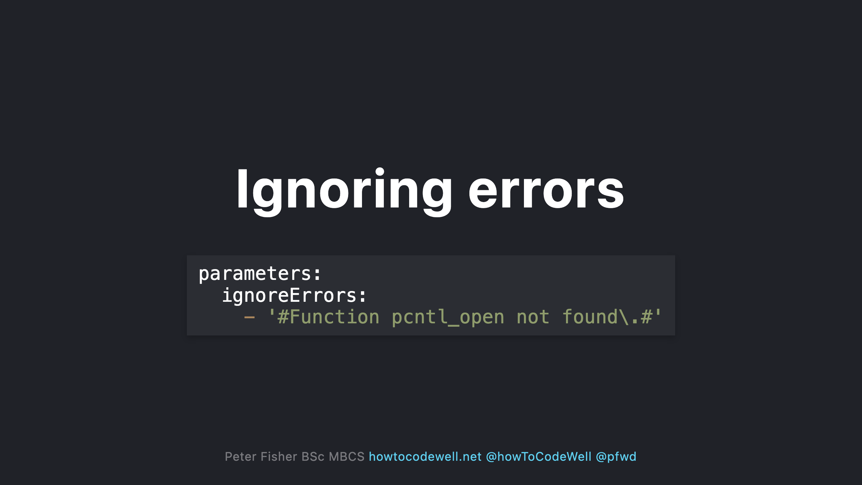

Slide 41
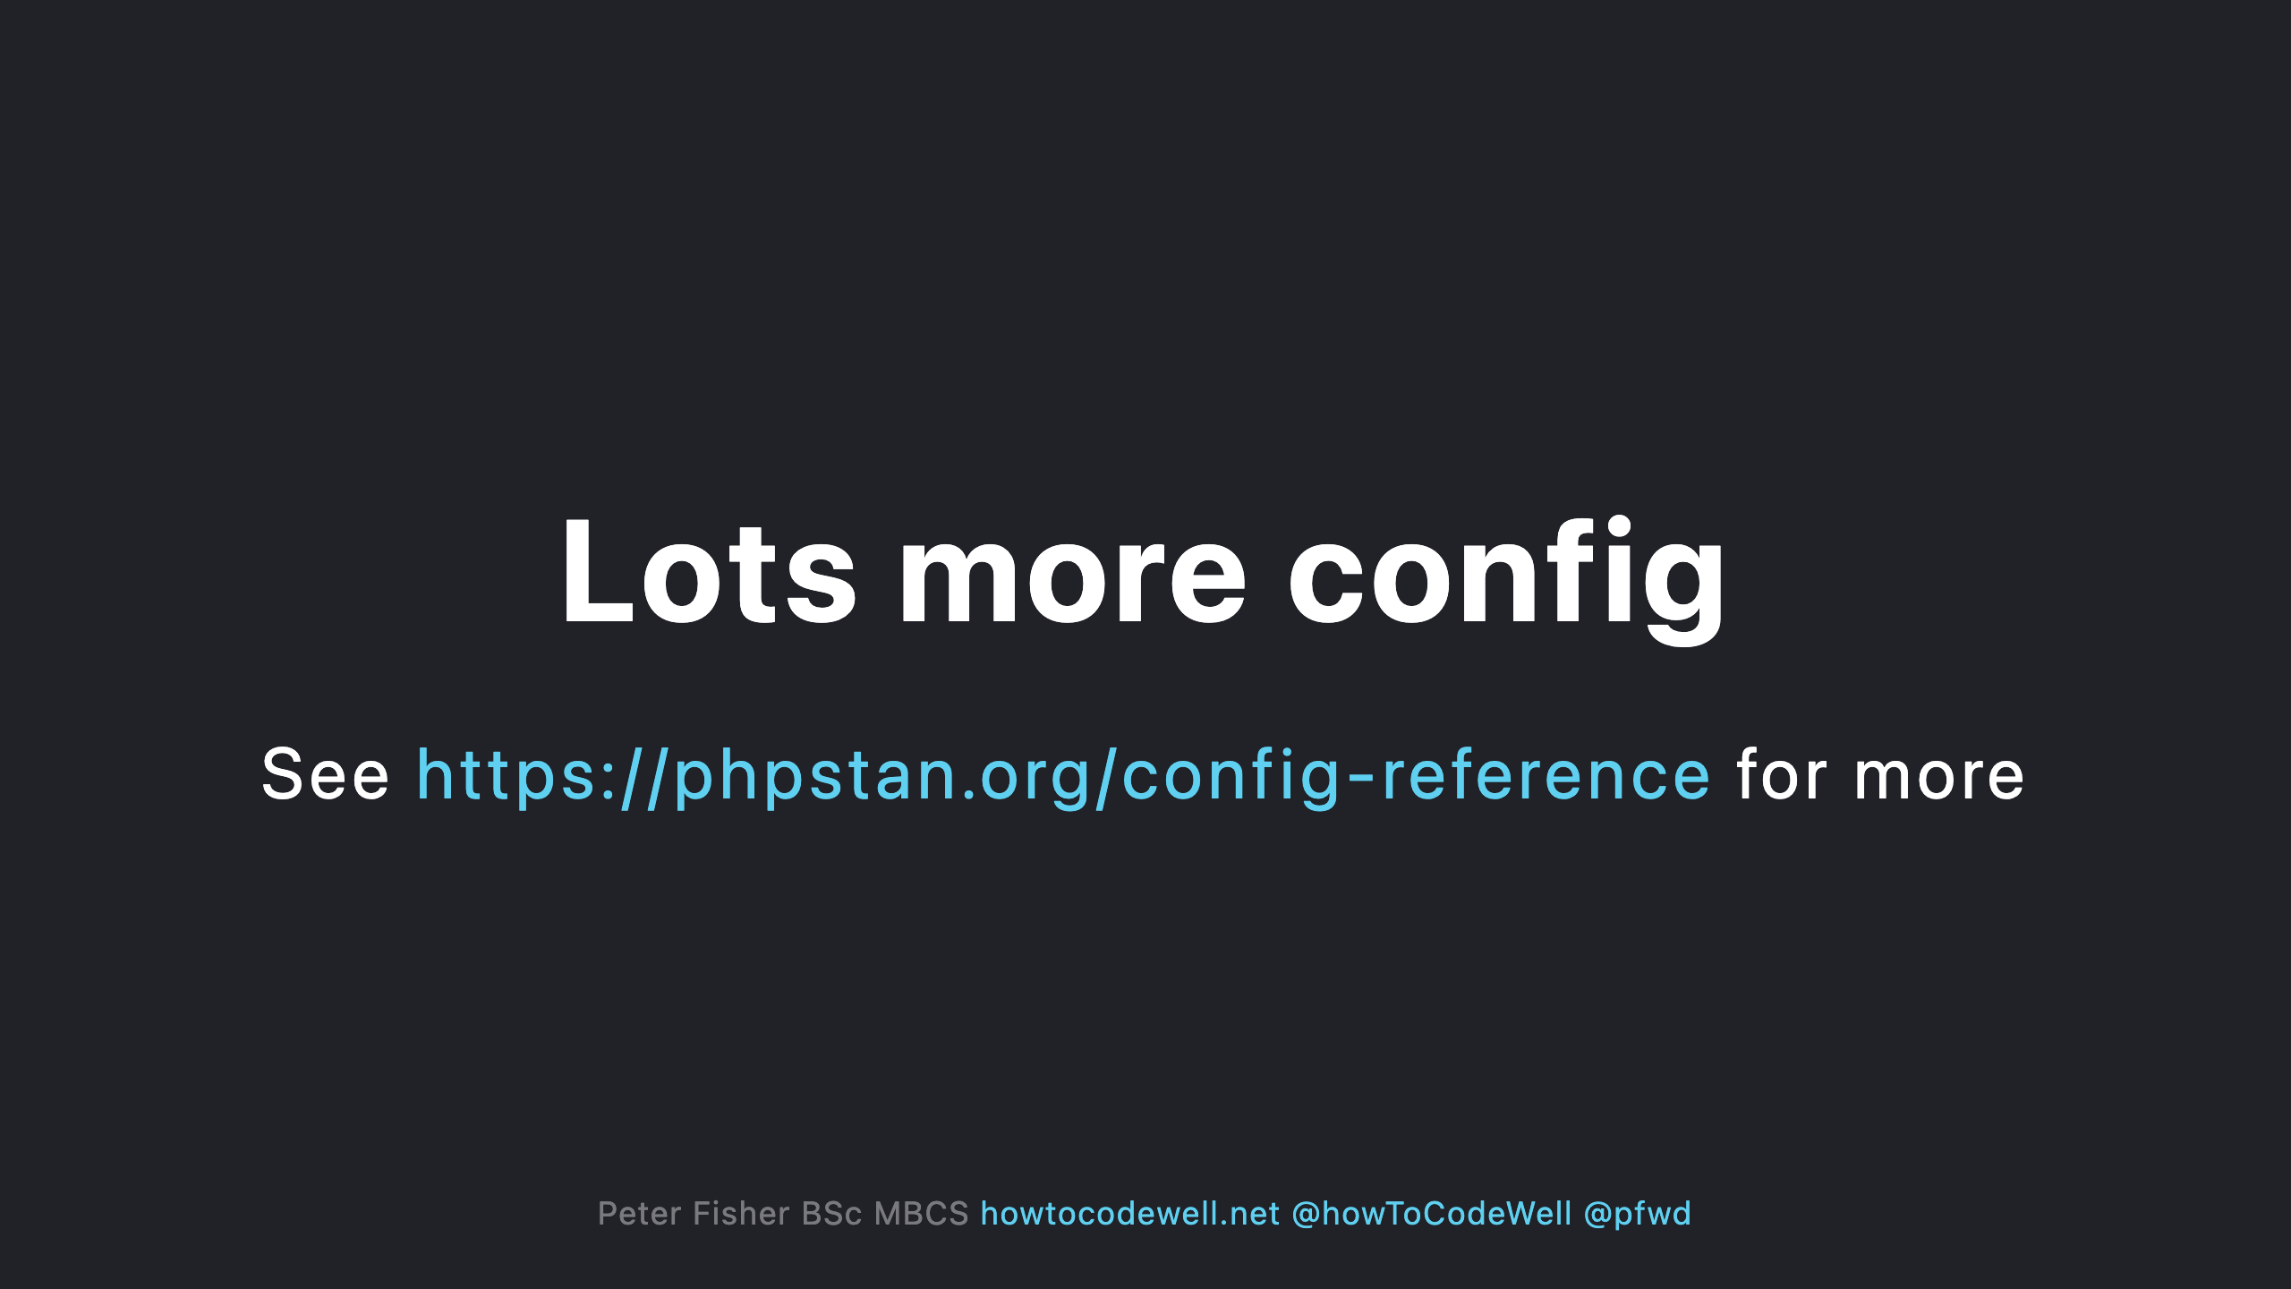
Notes:
Includes config switches to turn certain checks on and off

Slide 42
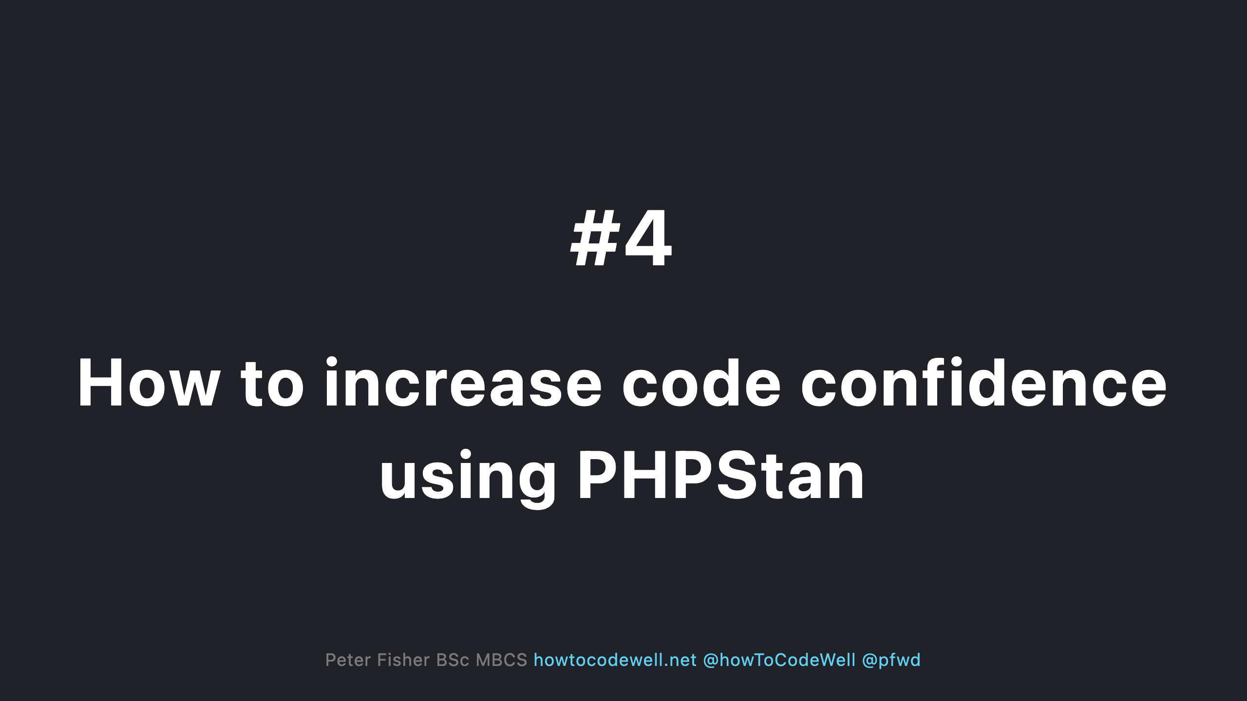

Slide 43
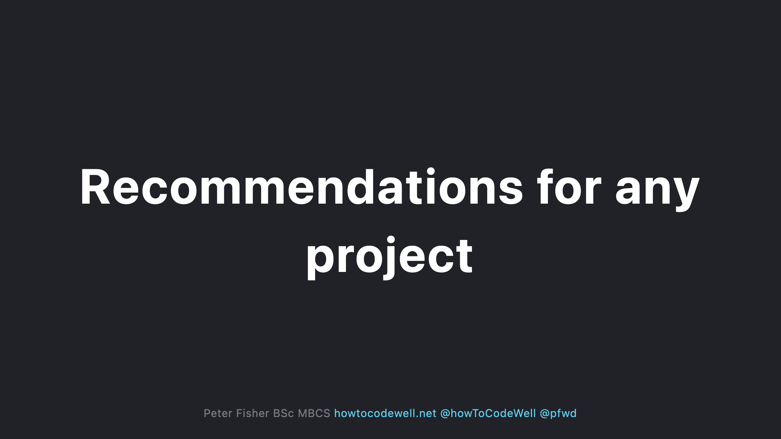

Slide 44
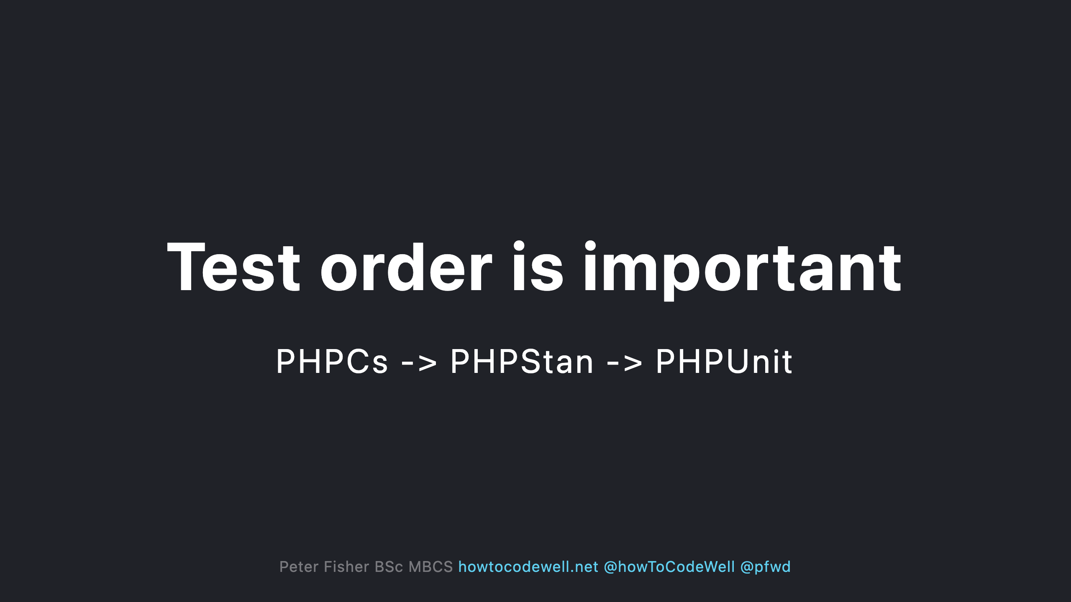

Slide 45
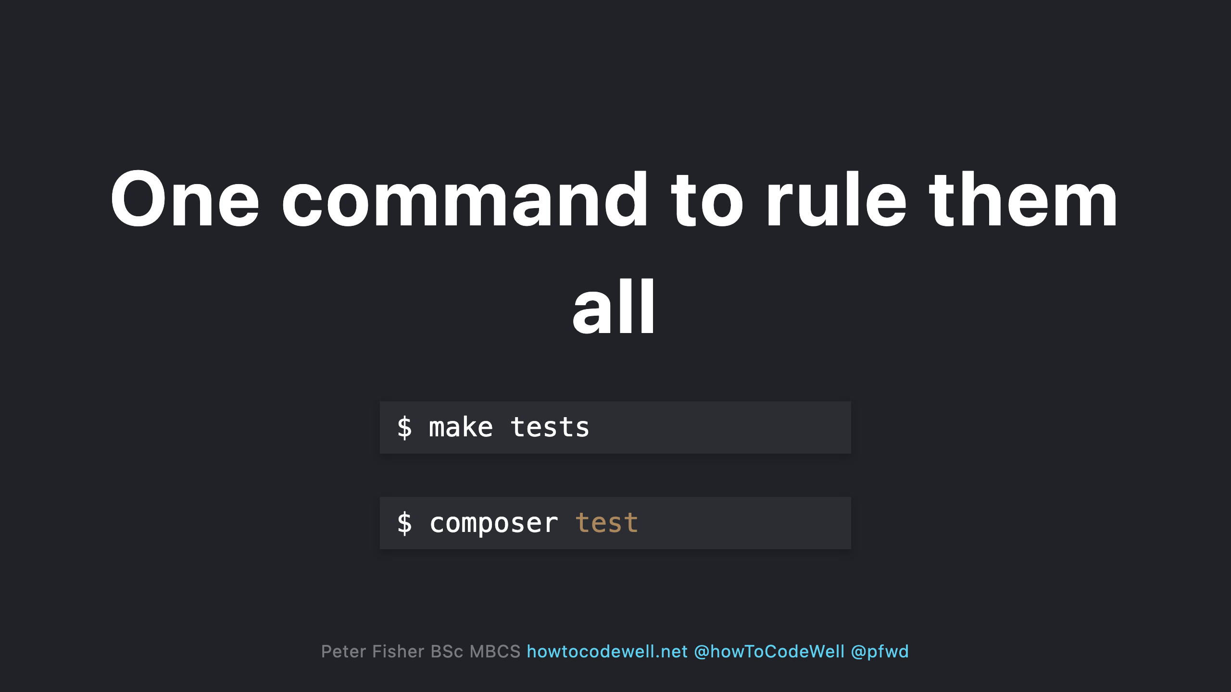

Slide 46
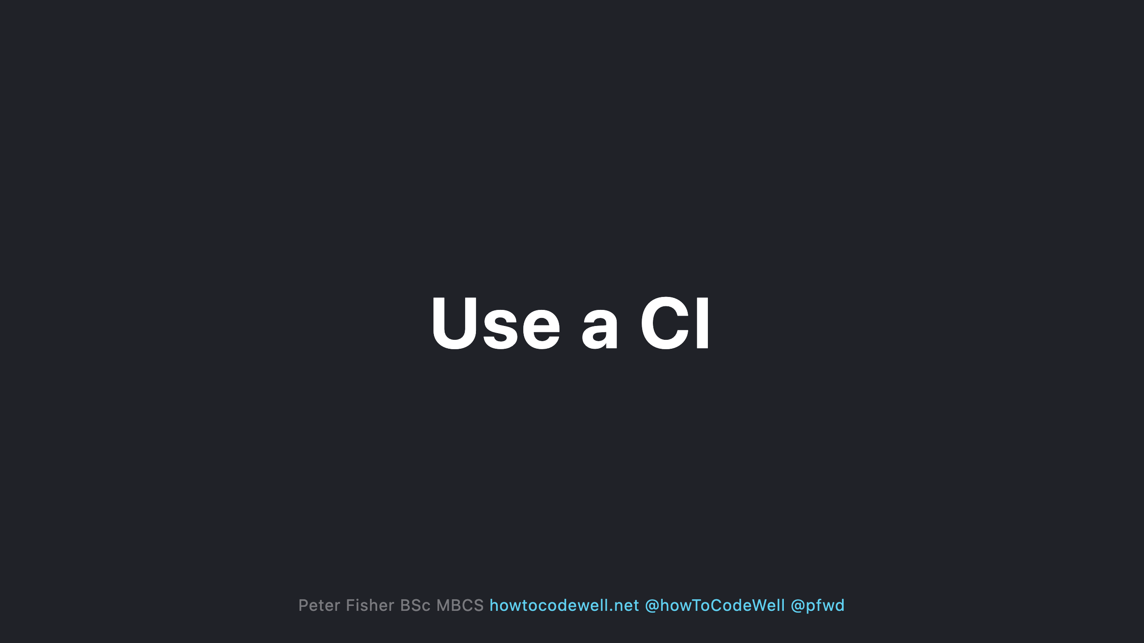
Notes:
- Enforce that no code can be merged into the main branches unless the CI fully passes

Slide 47
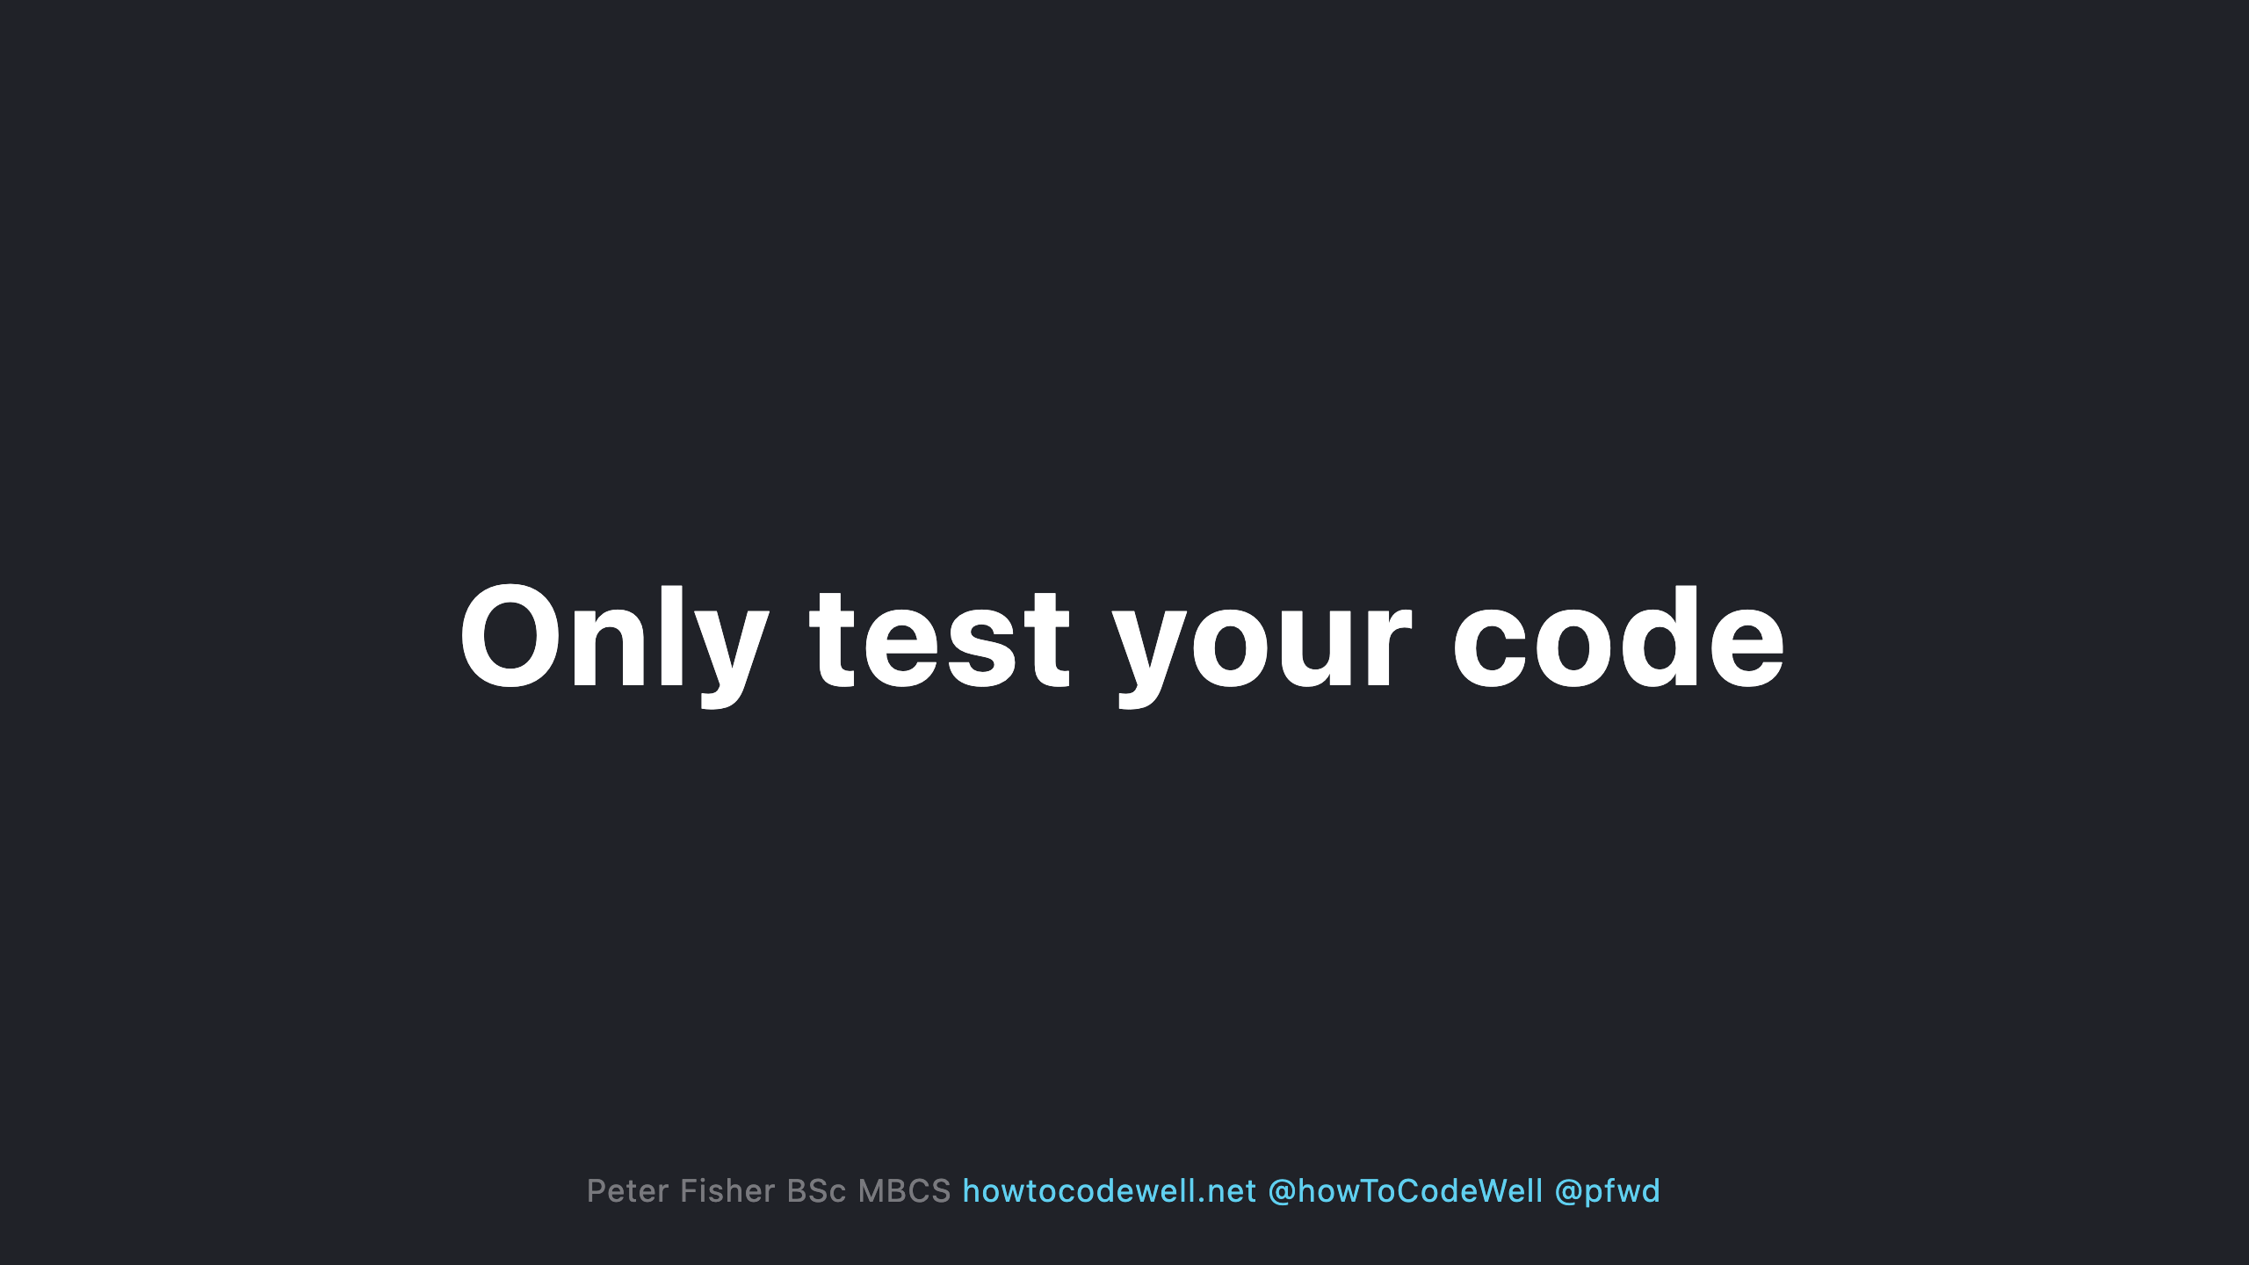
Notes:
- Don't analyse code that you haven't written. - Don't include the vendor - Ignore any code that is automatically generated like migrations

Slide 48
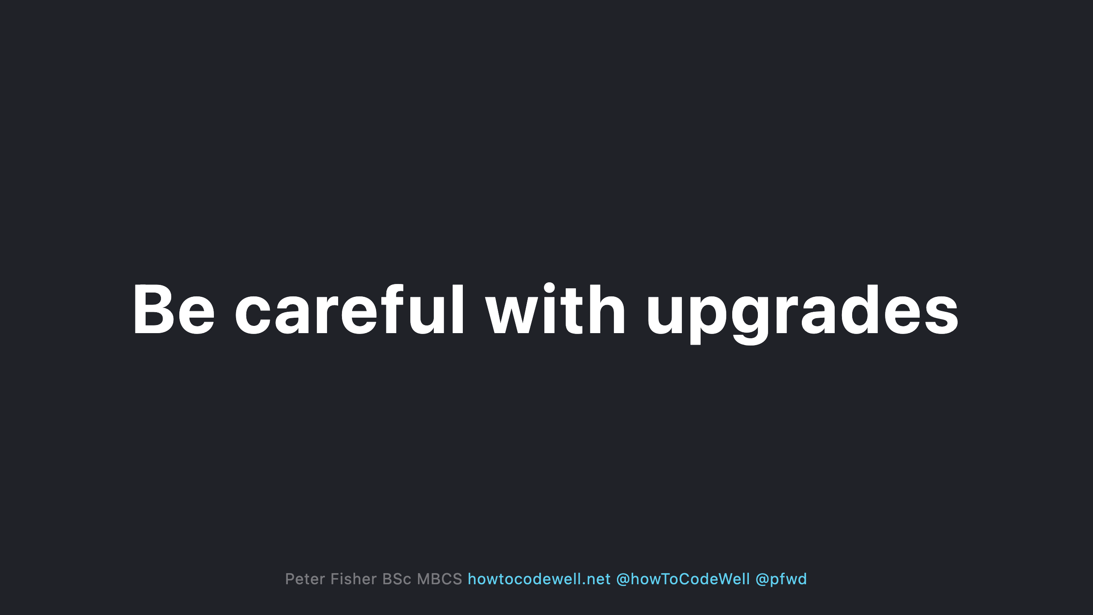
Notes:
- Don't upgrade your framework or PHP version until you have fixed all PHPStan errors - After upgrading your framework or PHP version run PHPStan as you may need to adjust your code - After upgrading PHPStan run PHPStan to check if anything new has been picked up

Slide 49
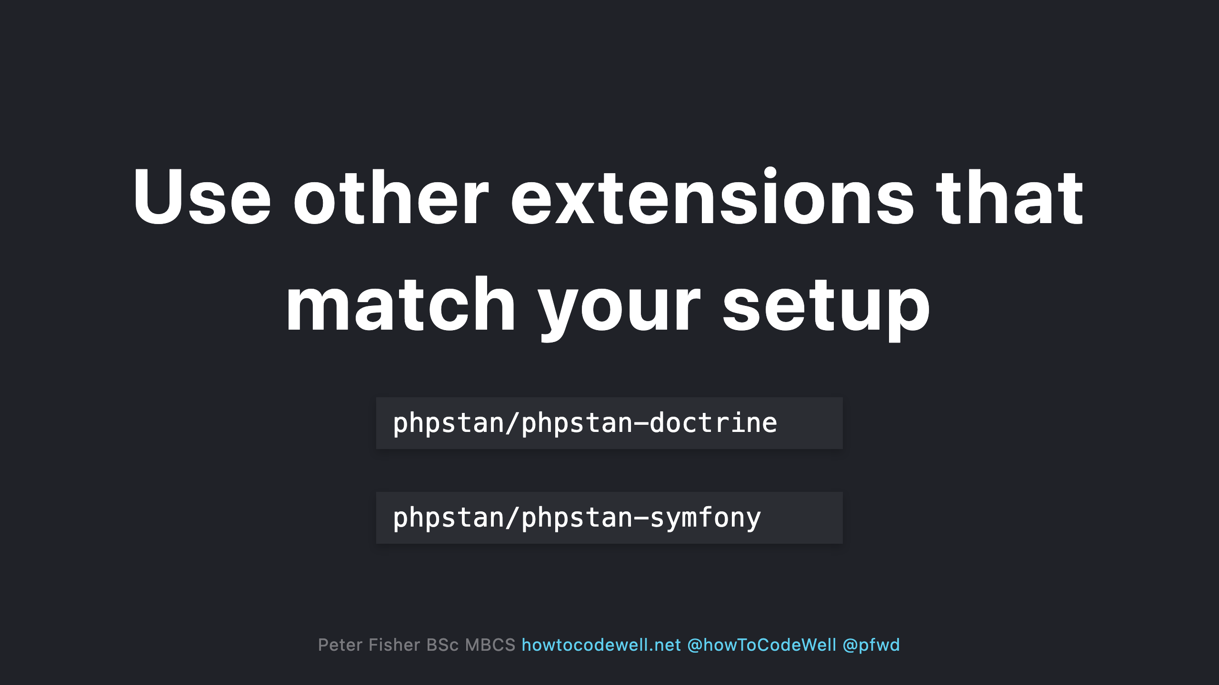

Slide 50
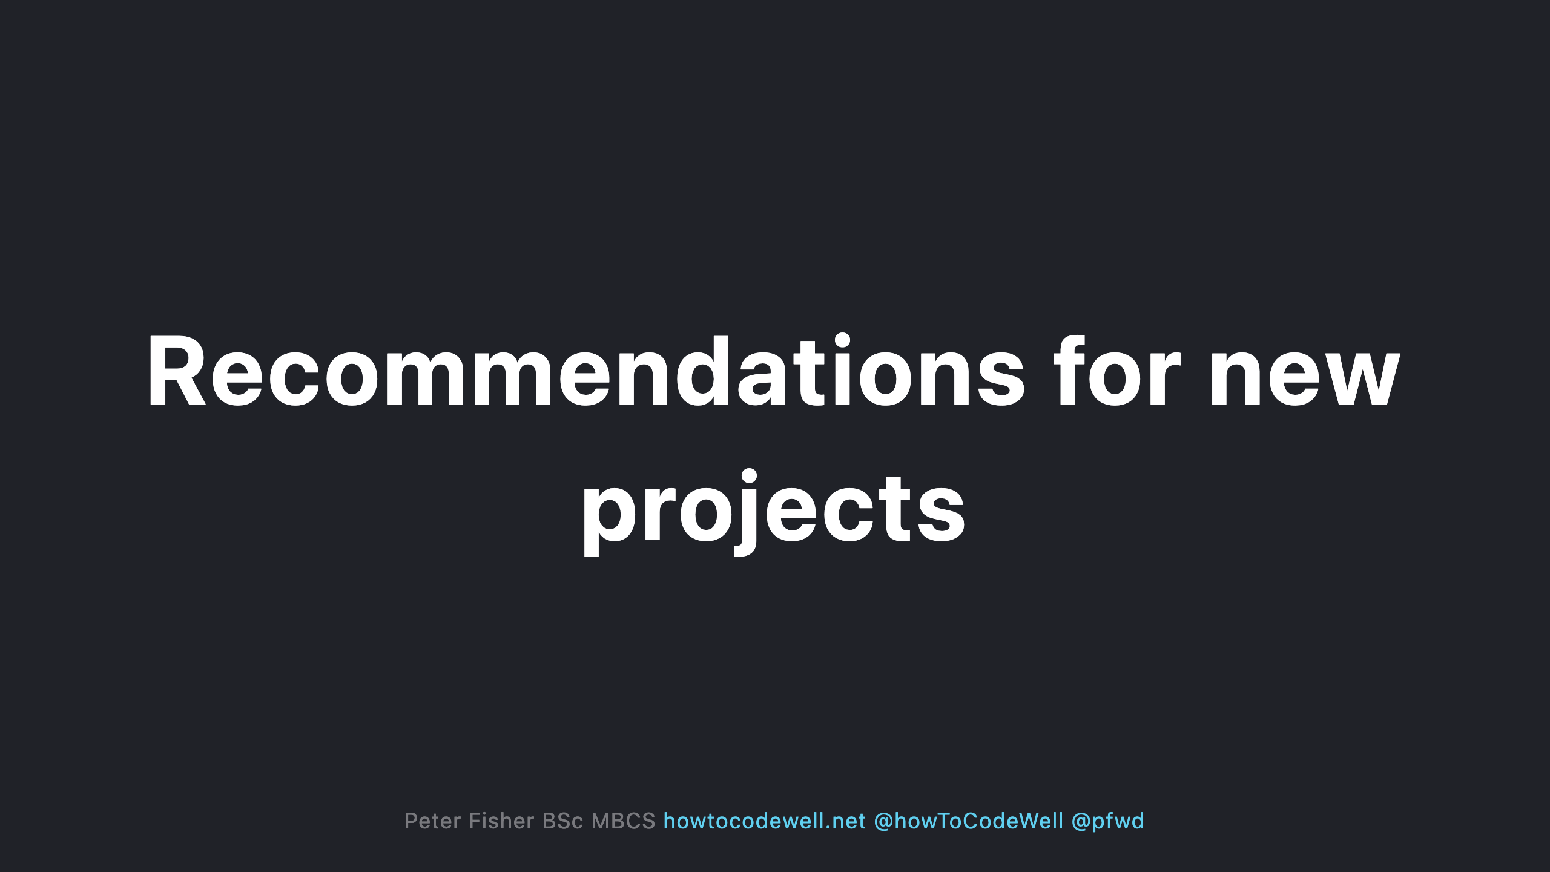
Notes:
- Only reduce the level if you are 100% sure you cannot fix the issue - Ignore one off errors via the config instead of opting to lower the level. You will end up missing other checks - Try to not ignore or exclude any errors

Slide 51
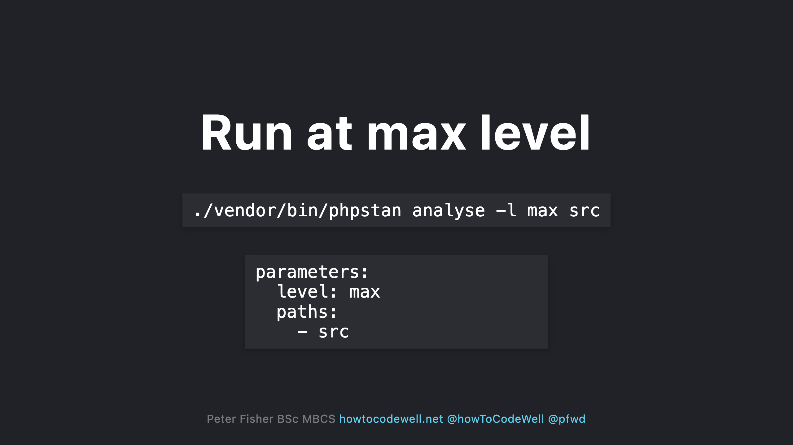
Notes:
- Use the the max level. This will keep you at the highest possible level when PHPstan is upgraded

Slide 52


Slide 53

Notes:
- Fix errors in a separate branch which doesn't contain other features/fixes - Ensure you have installed the correct support packages for your libraries and frameworks

Slide 54

Notes:
- This shows you what you are up against - Don't be afraid of what you might find - Keep note of how many errors you have

Slide 55

Notes:
- Do one level at a time - Do it gradually

Slide 56

Notes:
- Unit tests - Acceptance tests - Sometimes if its broken it actually works

Slide 57


Slide 58


Slide 59

Notes:
- Run the next base level via phpstan.neon - Mention what needs fixing to the team. They might not be aware that PHPStan has other levels - Attempt to fix a level per sprint - Rinse and repeat

Slide 60


Slide 61


Slide 62


Slide 63


Slide 64


Slide 65


Slide 66

Notes:
- Data integrity - What type is $product

Slide 67


Slide 68

Notes:
- Documents the requirements of the array - Autocompletion - Ideally use an interface if this a common occurrence

Slide 69


Slide 70

Notes:
Native type hint wont work for the array shape

Slide 71

Notes:
No need to use an annotation

Slide 72

Notes:
- Bugsnag or Sentry have pricing plans based on the number of events triggered. - The more compliant your code is the less events will be triggered

Slide 73


